Slide 1
Solid State Lattices

Slide 2
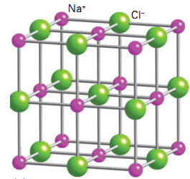
Face
NaCl Lattice
Corner
Edge

Slide 3
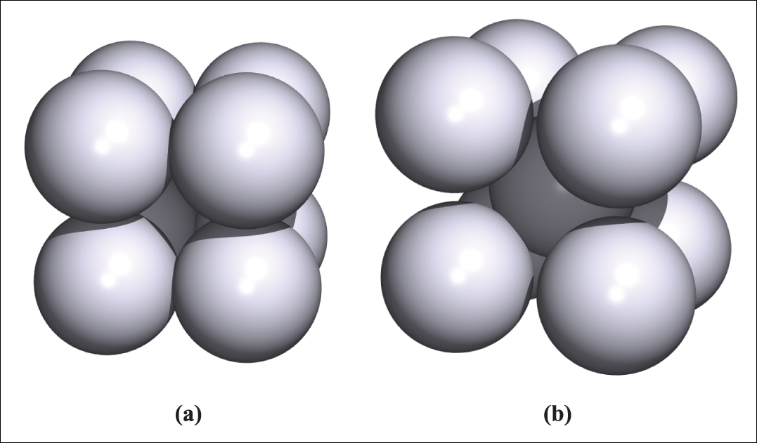
Figure 6.6 Unit cells of (a) a simple cubic lattice and (b) a body-centred cubic lattice.

Slide 4
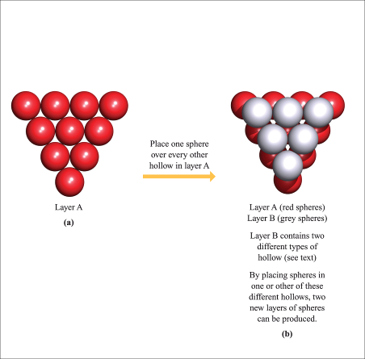
Figure 6.2 (a) One layer (layer A) of close-packed spheres contains hollows that exhibit a regular pattern. (b) A second layer (layer B) of close-packed spheres can be formed by occupying every other hollow in layer A. In layer B, there are two types of hollow; one lies over a sphere in layer A, and three lie over hollows in layer A. By stacking spheres over these different types of hollow, two different third layers of spheres can be produced.

Slide 5
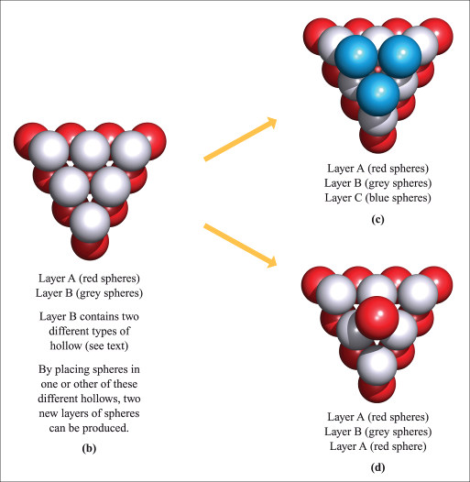
Figure 6.2 The blue spheres in diagram (c) form a new layer C; this gives an ABC sequence of layers. Diagram (d) shows that the second possible third layer replicates layer A; this gives an ABA sequence. (Continued)

Slide 6
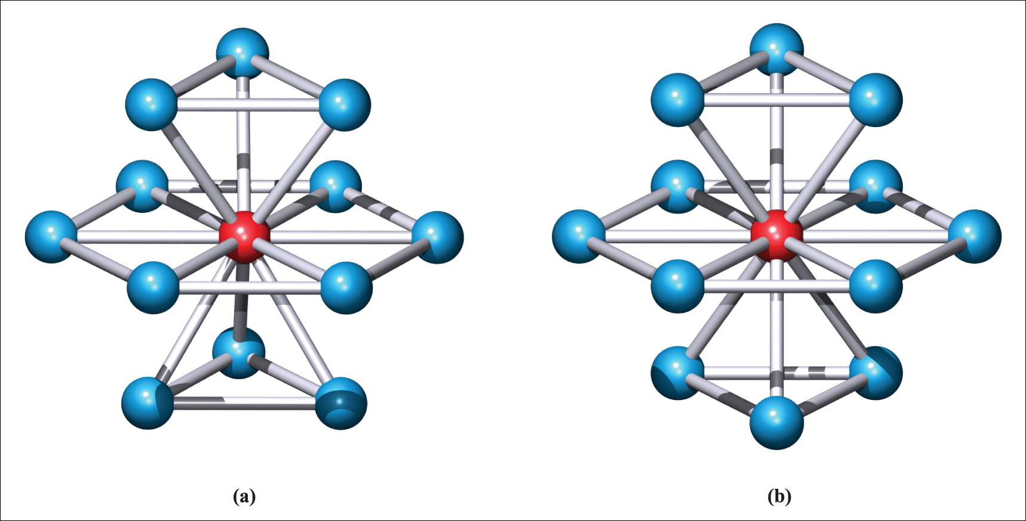
Figure 6.3 In both the (a) ABA and (b) ABC close-packed arrangements, the coordination number of each atom is 12.

Slide 7
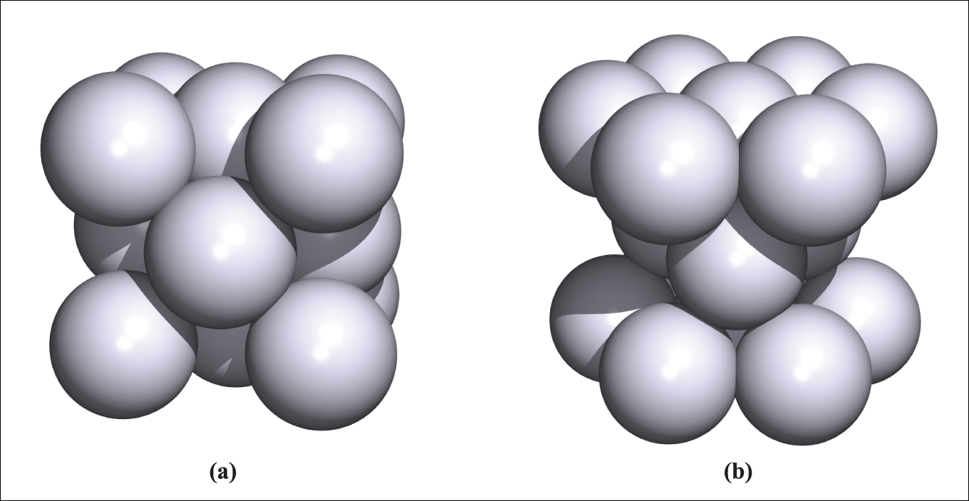
Figure 6.4 Unit cells of (a) a cubic close-packed (face-centred cubic) lattice and (b) a hexagonal close-packed lattice.

Slide 8
Face
NaCl Lattice
Corner
Edge

Slide 9
NaCl Lattice
Octahedral Hole

Slide 10
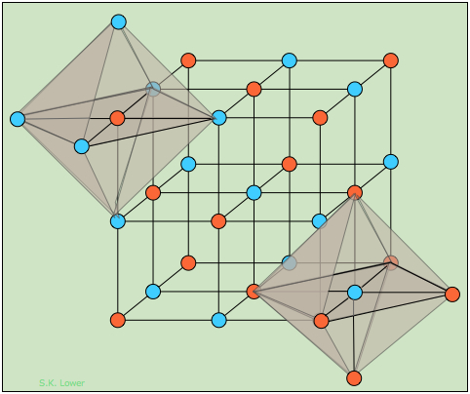
NaCl Lattice

Slide 11
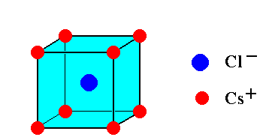
CsCl Lattice
Cubic Hole

Slide 12
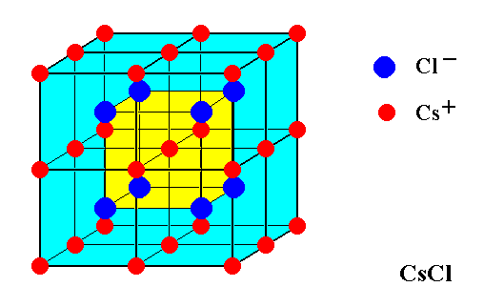
CsCl Lattice

Slide 13
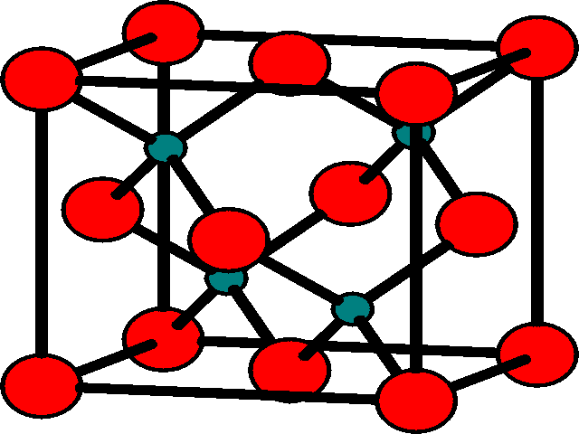
ZnS Zinc Blende Lattice
Empty Tetrahedral Hole
Tetrahedral
Hole

Slide 14
ZnS Blende Lattice
Empty Octahedral Hole

Slide 15
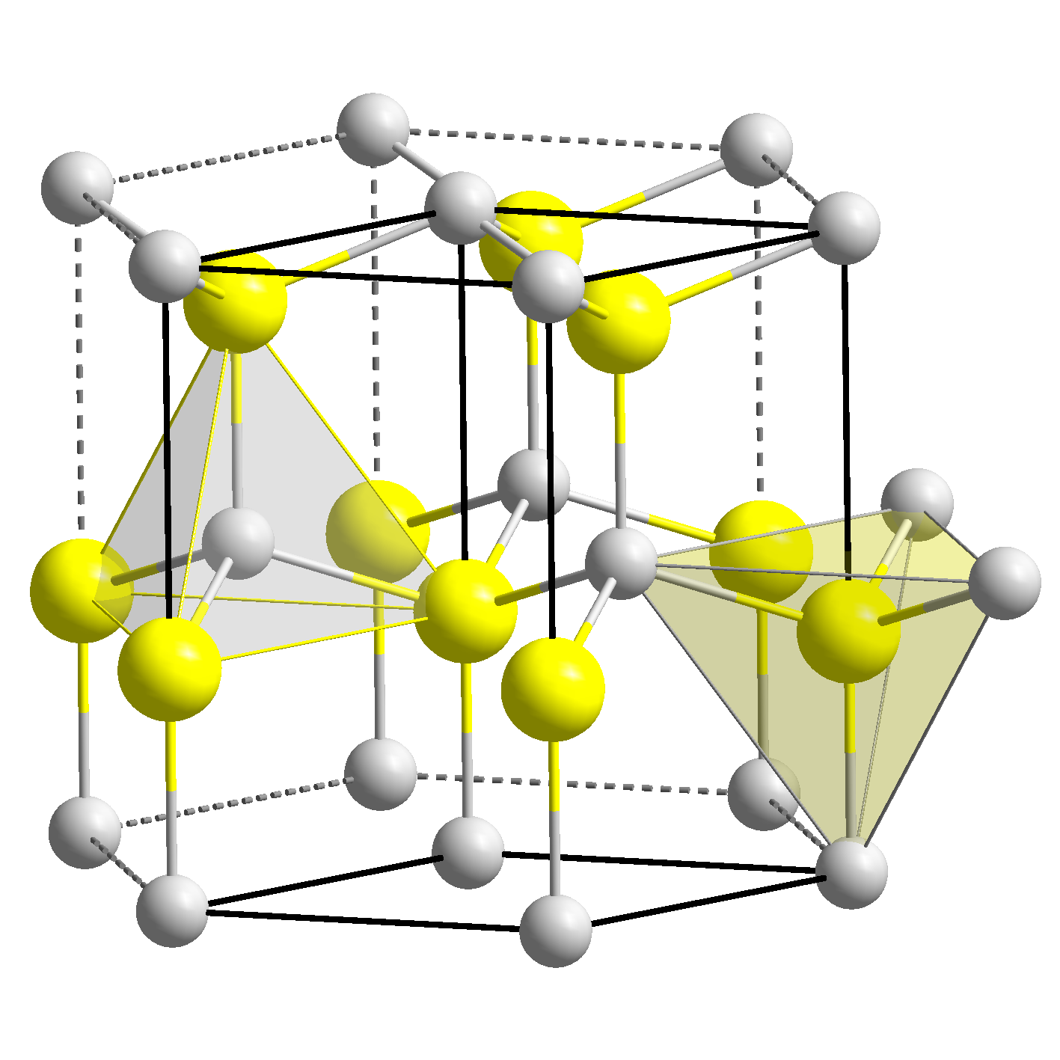
ZnS Wurtzite Lattice

Slide 16
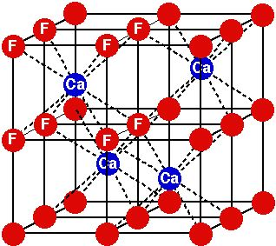
CaF₂ Fluorite Lattice
Cubic
Hole

Slide 17
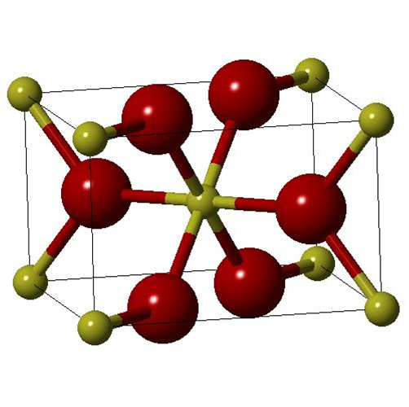
TiO₂ Rutile Lattice
Trigonal
Hole

Slide 18
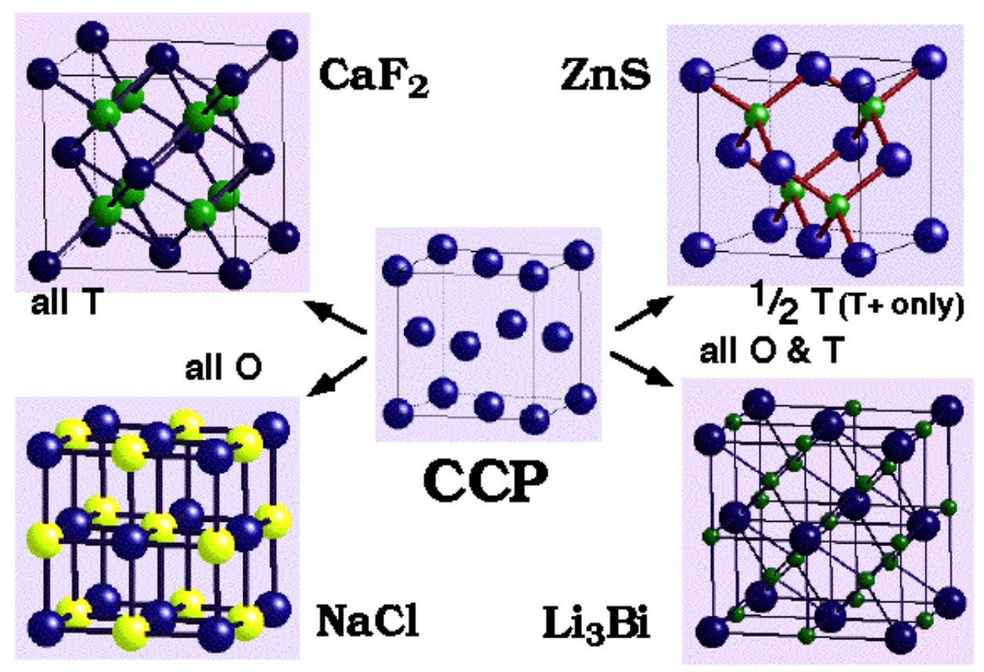
Ca²⁺
Zn²⁺
Bi³⁻
Na⁺

