Slide 1
Coordination Chemistry:
Electronic Spectroscopy (UV-Vis)

Slide 2
1. Electronic spectroscopy pertaining to d-orbital e⁻ (Introduction)
Typically occur in the visible range of light.

Slide 3
A. The Spectrochemical Series
I⁻ < Br ⁻ < [NCS]⁻ < Cl⁻ < F⁻ < [OH]⁻ < [ox]²⁻ ~ H₂O < [NCS]⁻ < NH₃ < en < [CN]⁻ ~ CO
σ donor
Weak field ligands
Strong field ligands
Ligands increasing Δ_{oct}
Small Δ
High spin
π donors
Large Δ
Low spin
π acceptors

Slide 4
Cobalt (III) Octahedral Complexes; d⁶
Weak field vs Strong field extremities dictated by ligand coordination.
e_{g}
e_{g}
Δ_{oct}
E
Δ_{oct}
t_{2g}
t_{2g}
Small Δ_{oct}
Weak Field, High spin
S = 2
Big Δ_{oct}
Strong Field, Low spin
S = 0

Slide 5
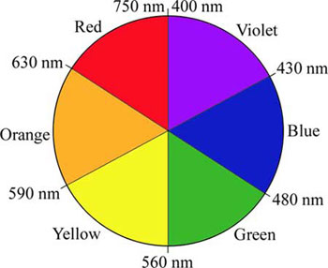
d-d electronic transition and Δ_{oct}
Δ_{oct} = E = hν = h c
λ
̶
Δ_{oct} , λ

Slide 6
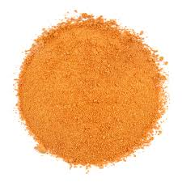
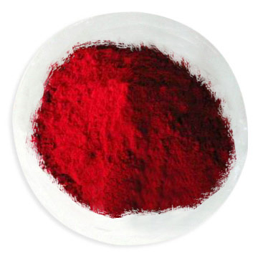
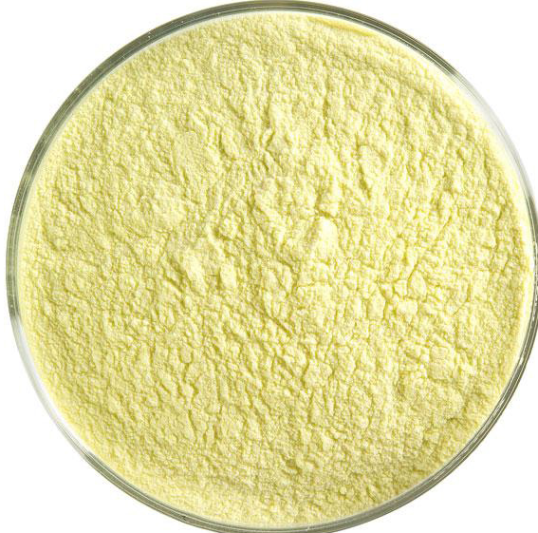
Cobalt (III) Octahedral Complexes; d⁶
I⁻ < Br ⁻ < [NCS]⁻ < Cl⁻ < F⁻ < [OH]⁻ < [ox]²⁻ ~ H₂O < [NCS]⁻ < NH₃ < en < [CN]⁻ ~ CO
3+
L = CN⁻
L = NH₃
L = H₂O

Slide 7
B. Electronic transition selection rules
Spin rule: Transitions must not involve a change of spin.
ΔS = 0
2. Laporte rule: Transitions must have a change of parity.
Gerade Ungerade
No gerade gerade nor ungerade ungerade
Technically all d-d electronic transitions are forbidden
gerade
gerade

Slide 8
I. Spin forbidden d-d e⁻ transitions
[Mn(H₂O)₆]²⁺ is high-spin d⁵ Mn(II):
e_{g}
t_{2g}
S = 2.5
S = 1.5
Extremely weak transitions; ε < 1 M⁻¹cm⁻¹
RECALL Beer’s Law: A = ε b c
ε is a property of the absorbance of a chemical species
A measure of the intensity of an electronic transition

Slide 9
II. Laporte forbidden d-d e⁻ transitions
For ideal octahedral complexes, d-d e⁻ transitions are spin-allowed but Laporte forbidden
Extremely weak transitions; ε = 10 - 200 M⁻¹cm⁻¹
i.e. [Co(H₂O)₆]³⁺ is high-spin d⁶ Co(III):
e_{g}
t_{2g}
S = 2
S = 2

Slide 10
II. Laporte forbidden d-d e⁻ transitions
B. For ideal tetrahedral complexes, d-d e⁻ transitions are spin-allowed but “less” Laporte forbidden than octahedral complexes because they are non-centrosymmetric complexes.
ε = 100 – 1,000 M⁻¹cm⁻¹
i.e. [Ni(Cl)₄]²⁻ is high-spin d⁸ Ni(II):
t₂
t₂
e
e
S = 1
S = 1

Slide 11
2. Charge transfer electronic transitions
Charge transfer e⁻ transitions are Spin and Laporte allowed; ε > 1,000 M⁻¹cm⁻¹
Typically observed in the UV range of light
Ligand to metal charge transfer (LMCT)
Transfer of an electron from an orbital with primarily ligand character to one with primarily metal character
Can be observed with π donor ligands
Metal to ligand charge transfer (MLCT)
Transfer of an electron from an orbital with primarily metal character to one with primarily ligand character
Can be observed with π acceptor ligands
e⁻
M
L
e⁻
M
L

Slide 12
3. Solution preparations to observe e⁻ transitions
Concentrated solutions of coordination complexes need to be made to observe d-d e⁻ transitions
mM concentrations
Dilute solutions of coordination complexes need to be made to observe charge transfer e⁻ transitions
μM concentrations

Slide 13
4. A closer look at d-d e⁻ transitions
Requires an extension of crystal field theory by treating the ligand field as not a purely electrostatic model
Ligand field theory
Must consider the atomic state of a multi-electron system and the allowed electronic transitions
Must consider transitions in weak field and strong field coordinations

Slide 14
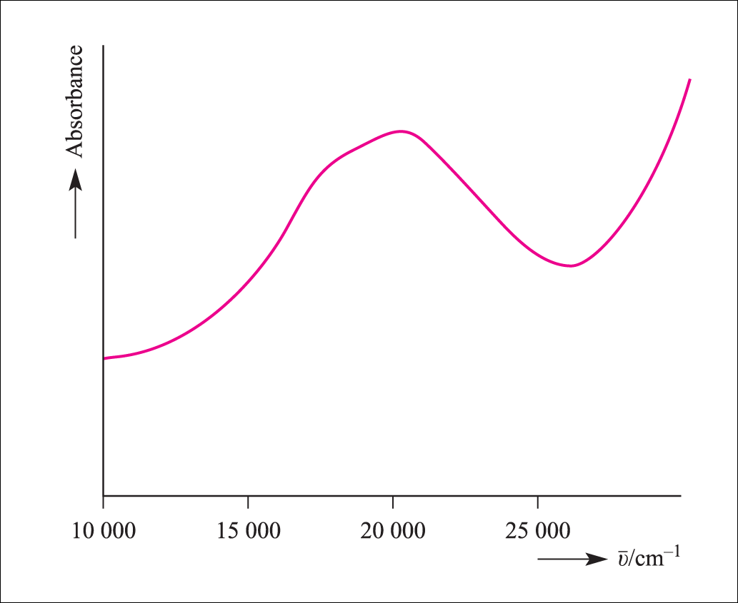
A d¹ absorbance
Consider a d¹ electron configuration:
i.e. [Ti(H₂O)₆]³⁺ Ti³⁺
Electronic
absorbance
Ground State
d_{z}²
d_{z}²
d_{z}²
d_{x}² – _{y}²
d_{x}² – _{y}²
d_{x}² – _{y}²
d_{xz}
d_{yz}
d_{xz}
d_{yz}
d_{xz}
d_{yz}
d_{xy}
d_{xy}
d_{xy}

Slide 15
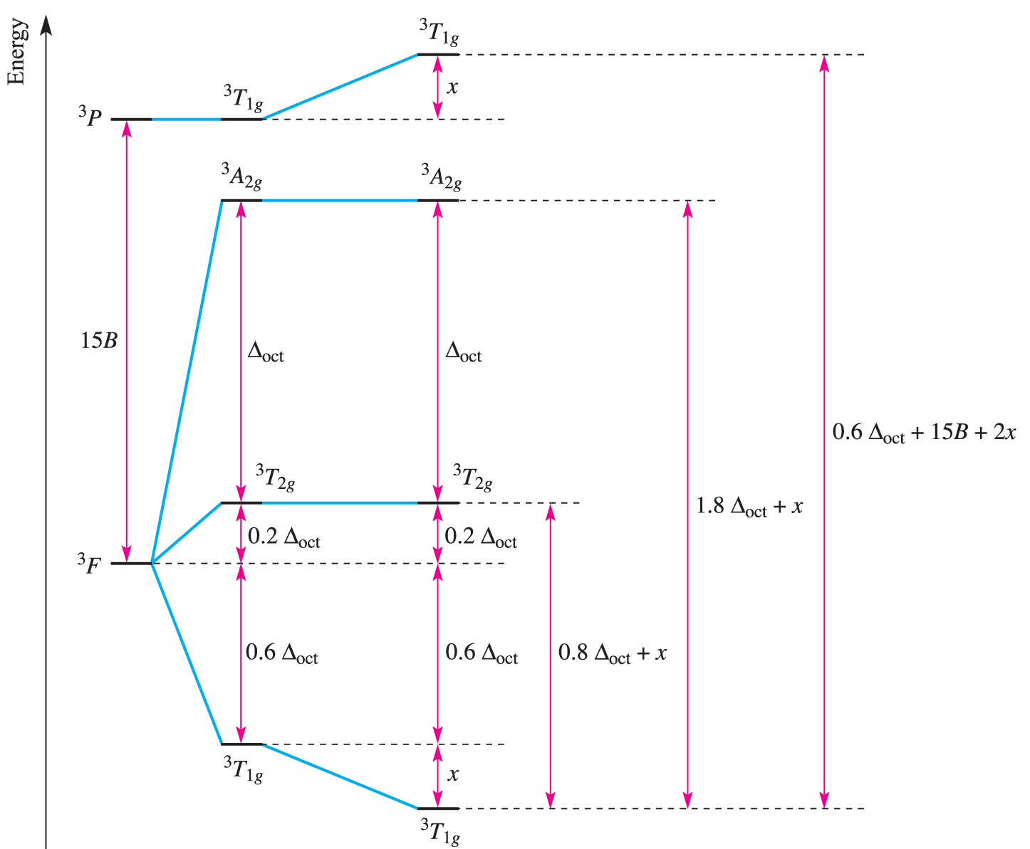
Simplified d² Orgel Diagram
To determine Δ_{oct,} need to approximate the value of the Racah parameter B
B accounts for electron-electron repulsions
A measure of the splitting of the initial atomic states

Slide 16
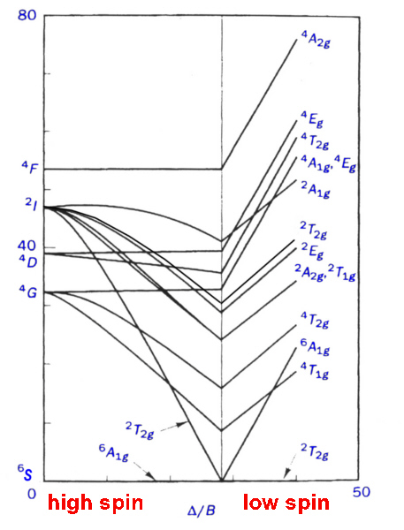
d⁵ Tanabe-Sugano Diagram
Weak field (high spin)
⁶A_{1g} is the ground state
No spin-allowed transitions
Strong field (low spin)
²T_{2g} is the ground state
Four allowed transitions
²T_{2g} to ²A_{2g} or ²T_{2g} to ²T_{1g}
²T_{2g} to ²E_{g}
²T_{2g} to ²T_{2g} (²I)
²T_{2g} to ²A_{1g}
Four absorbances but due to resolution may not actually see them

