Slide 1
Coordination Chemistry:
Bonding Theories
Crystal Field Theory

Slide 2
1. Chemistry of the d-orbitals

Slide 3
2. Crystal Field Theory
A purely electrostatic consideration
Ligand electrons create an electric field around the metal center
Ligands are point charges and we do not take their orbitals into consideration
No metal-ligand covalent interactions

Slide 4
3. Energy of the d-orbitals
The energy of the five
d orbitals of the transition metals is equal in the absence of ligands.
M

Slide 5
3. Energy of the d-orbitals
A spherical distribution of ligand electrons equally destabilizes the energy of the d orbital electrons.
Degenerate 3d atomic orbitals

Slide 6
3. Energy of the d-orbitals
Degenerate 3d atomic orbitals

Slide 7
3. Energy of the d-orbitals
In an octahedral coordination environment:
The axial ligands interact directly with the two lobes of the d_{z2} orbital while the equatorial ligands interact with the toroid lobe
The equatorial ligands interact directly with the four lobes of the d_{x2 – y2} orbital
The d_{z2} and d_{x2 – y2} orbitals are destabilized whereas the d_{xy}, d_{xz}, and d_{yz} are stabilized

Slide 8
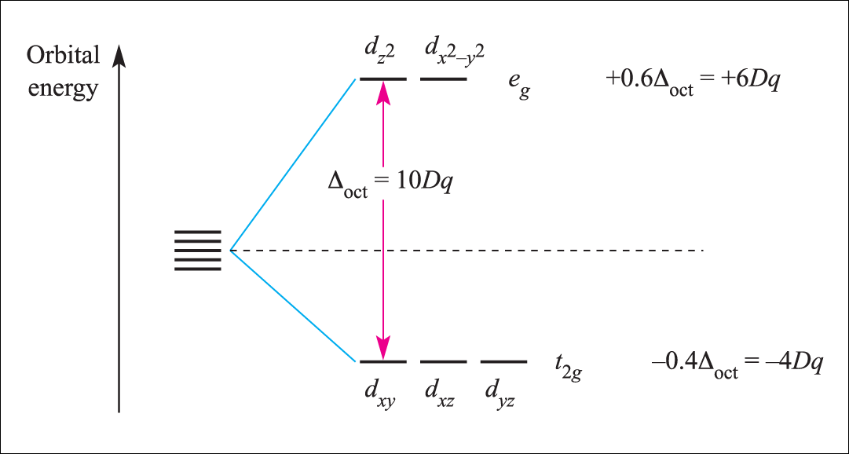
4. The Octahedral Crystal Field
Octahedral coordination environment:
Point Group: O_{h}
d_{z2} and d_{x2 – y2} orbitals: e_{g} symmetry
d_{xy}, d_{xz}, and d_{yz} : t_{2g} symmetry

Slide 9
4. The Octahedral Crystal Field
Octahedral coordination environment:
Point Group: O_{h}
d_{z2} and d_{x2 – y2} orbitals: e_{g} symmetry
d_{xy}, d_{xz}, and d_{yz} : t_{2g} symmetry
Destabilized
Stabilized

Slide 10
4. The Octahedral Crystal Field
Octahedral coordination environment:
Point Group: O_{h}
d_{z2} and d_{x2 – y2} orbitals: e_{g} symmetry
d_{xy}, d_{xz}, and d_{yz} : t_{2g} symmetry
Bary Center

Slide 11
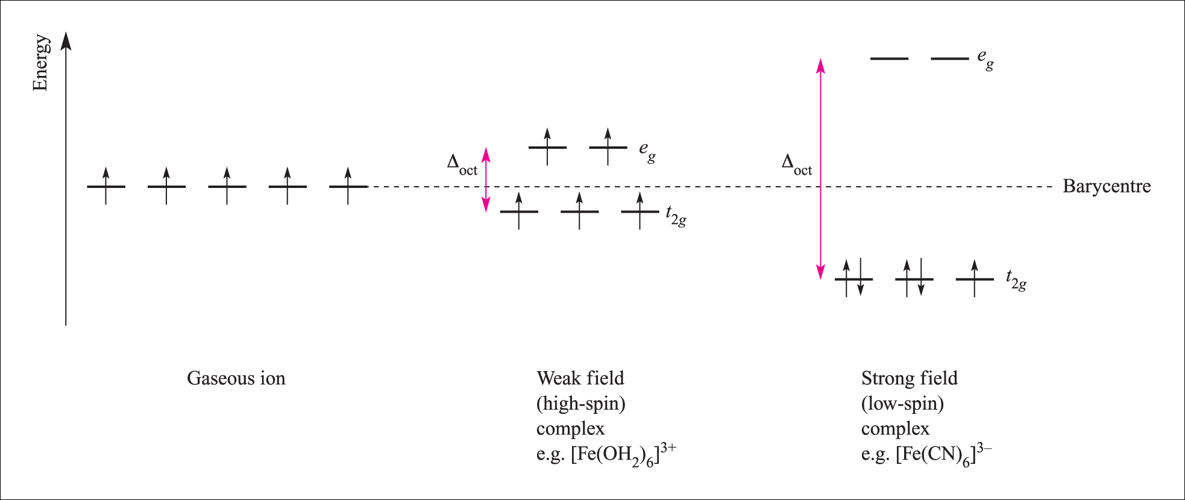
A. The Magnitude of Δ_{oct}
Determined by the strength of the crystal field:
Weak field
Strong field
Δ_{oct} (weak field) < Δ_{oct} (strong field)
d⁵ electron configuration
e⁻ prefer to go into higher energy orbitals than pair
e⁻ prefer to pair first

Slide 12
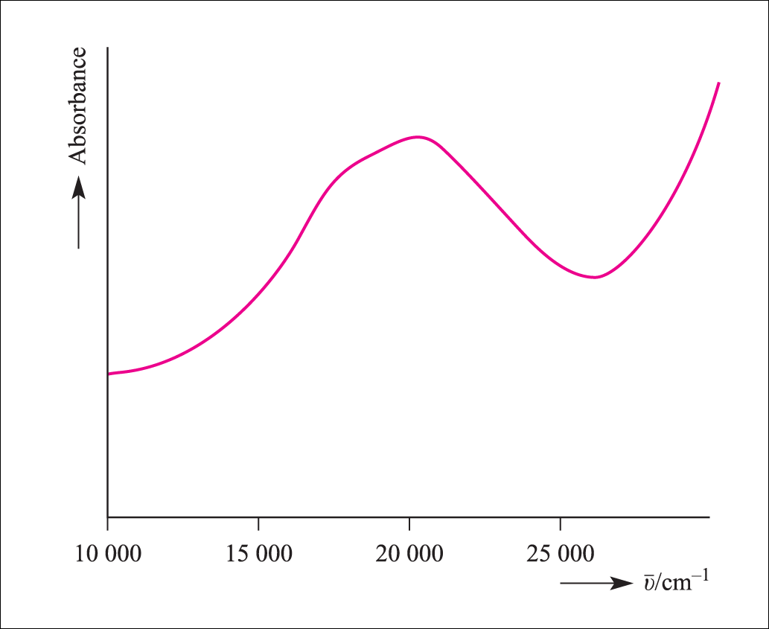
B. Crystal Field Stabilization Energy (CFSE)
Consider a d¹ electron configuration:
i.e. [Ti(H₂O)₆]³⁺ Ti³⁺
Electronic
absorbance
Ground State
Δ_{oct}
The single electron will be in less energetic ground state.
Δ_{oct}

Slide 13
B. Crystal Field Stabilization Energy (CFSE)
Calculate the magnitude by which the single electron is stabilized
+0.6Δ_{oct}
t_{2g}¹
+0.4Δ_{oct}
CFSE = -[(# electrons in t_{2g}) x 0.4Δ_{oct} ] + [(# electrons in e_{g}) x 0.6Δ_{oct}]
= -[ 1 x 0.4Δ_{oct} ] + [ 0 ] = -0.4Δ_{oct}
Relative to the bary center

Slide 14
C. CFSE and High vs Low Spin
Consider a d⁴ electron configuration (Cr²⁺):
Pairing has to be invoked
Δ_{oct} < p (pairing energy)
Weak Field, High spin
Δ_{oct} > p
Strong Field, Low spin
t_{2g}³ e_{g}¹
t_{2g}⁴
CFSE = -[ 3 x 0.4Δ_{oct} ] + [ 1 x 0.6Δ_{oct} ] = -0.6Δ_{oct}
CFSE = -[ 4 x 0.4Δ_{oct} ] = -1.6Δ_{oct} + 1 p

Slide 15
I. What determines p?
i. Inherent coulombic repulsion with n
The more diffuse the orbital, the more able to have two electrons
ii. Loss of exchange energy as e⁻ pair

Slide 16
II. What determines Δ?
Oxidation state of the metal ion
Δ with ionic charge
Nature of M
3d < 4d < 5d
Really big Δ, normally low spin (As you go down the periodic table, Δ)
Number and geometry of ligands
Δ_{tetrahedral} only ~50% of Δ_{octahedral}

Slide 17
II. What determines Δ?
iv. Nature of ligands
Spectrochemical series (partial)
I⁻ < Br ⁻ < [NCS]⁻ < Cl⁻ < F⁻ < [OH]⁻ < [ox]²⁻ ~ H₂O < [NCS]⁻ < NH₃ < en < [CN]⁻ ~ CO
Weak field ligands
Strong field ligands
Ligands increasing Δ_{oct}
YOU CAN NOT UNDERSTAND THIS TREND WITH CRYSTAL FIELD THEORY

Slide 18
5. Octahedral Geometry Distortions
Tetragonal distortions known as the Jahn-Teller Effect
Z-in
Z-out
D_{4h}
O_{h}
D_{4h}
d_{z}²
d_{x}² – _{y}²
d_{x}² – _{y}²
d_{z}²
d_{x}² – _{y}²
d_{z}²
d_{xz}
d_{yz}
d_{xy}
d_{xy}
d_{xy}
d_{xz}
d_{yz}
d_{xz}
d_{yz}

Slide 19
Jahn-Teller Effect
The theorem states that degenerate orbitals cannot be unequally occupied.
The molecule distorts by lowering its symmetry to remove the degeneracy
Quite common for octahedral complexes of d⁹ (Cu²⁺) and high-spin d⁴ ions
For Cu²⁺ complexes, a Z-out ligand arrangement is common.

Slide 20
5. Octahedral Geometry Distortions
What about a d¹ electron configuration?
D_{4h}
O_{h}
D_{4h}
d_{z}²
d_{x}² – _{y}²
d_{x}² – _{y}²
d_{z}²
d_{x}² – _{y}²
d_{z}²
YES!!!
Degeneracy
Removed
d_{xz}
d_{yz}
No
d_{xy}
d_{xy}
d_{xz}
d_{yz}
No
d_{xy}
d_{xz}
d_{yz}

Slide 21
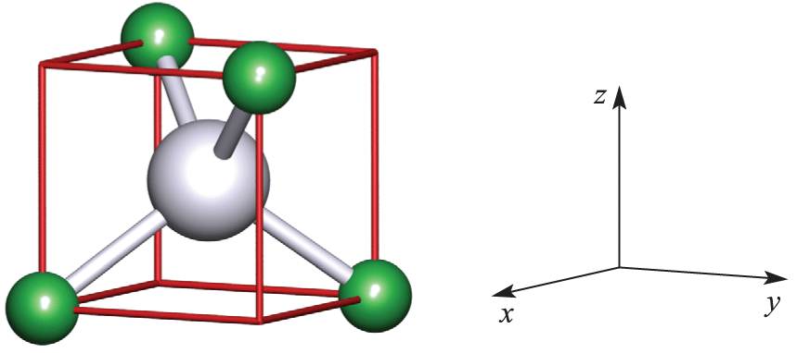
6. The Tetrahedral Crystal Field
Tetrahedral coordination environment:
Point Group: T_{d}
d_{z2} and d_{x2 – y2} orbitals: e symmetry; these orbitals are not in direct contact with the ligands
d_{xy}, d_{xz}, and d_{yz} : t₂ symmetry; these orbitals are in semi contact with the ligands

Slide 22
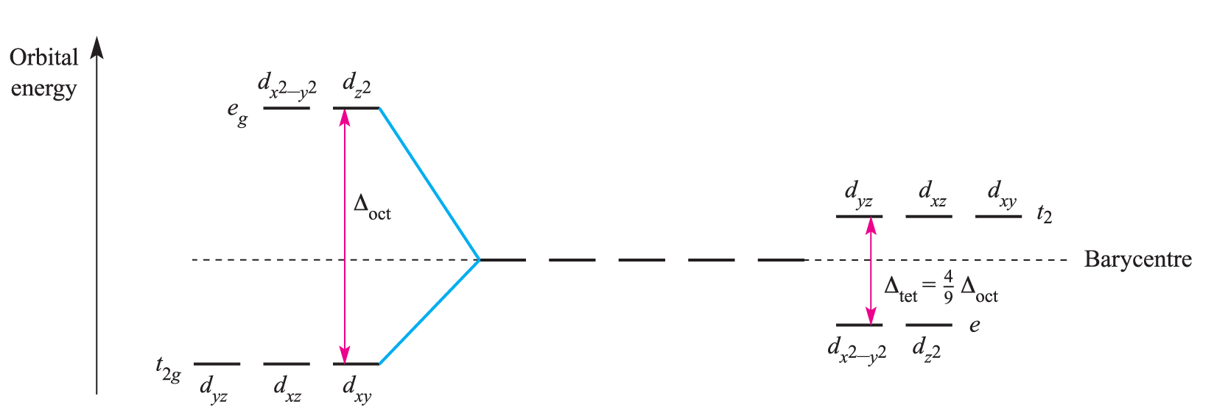
6. The Tetrahedral Crystal Field
Mostly high spin for these types of complexes.
Δ_{tet} < p

Slide 23
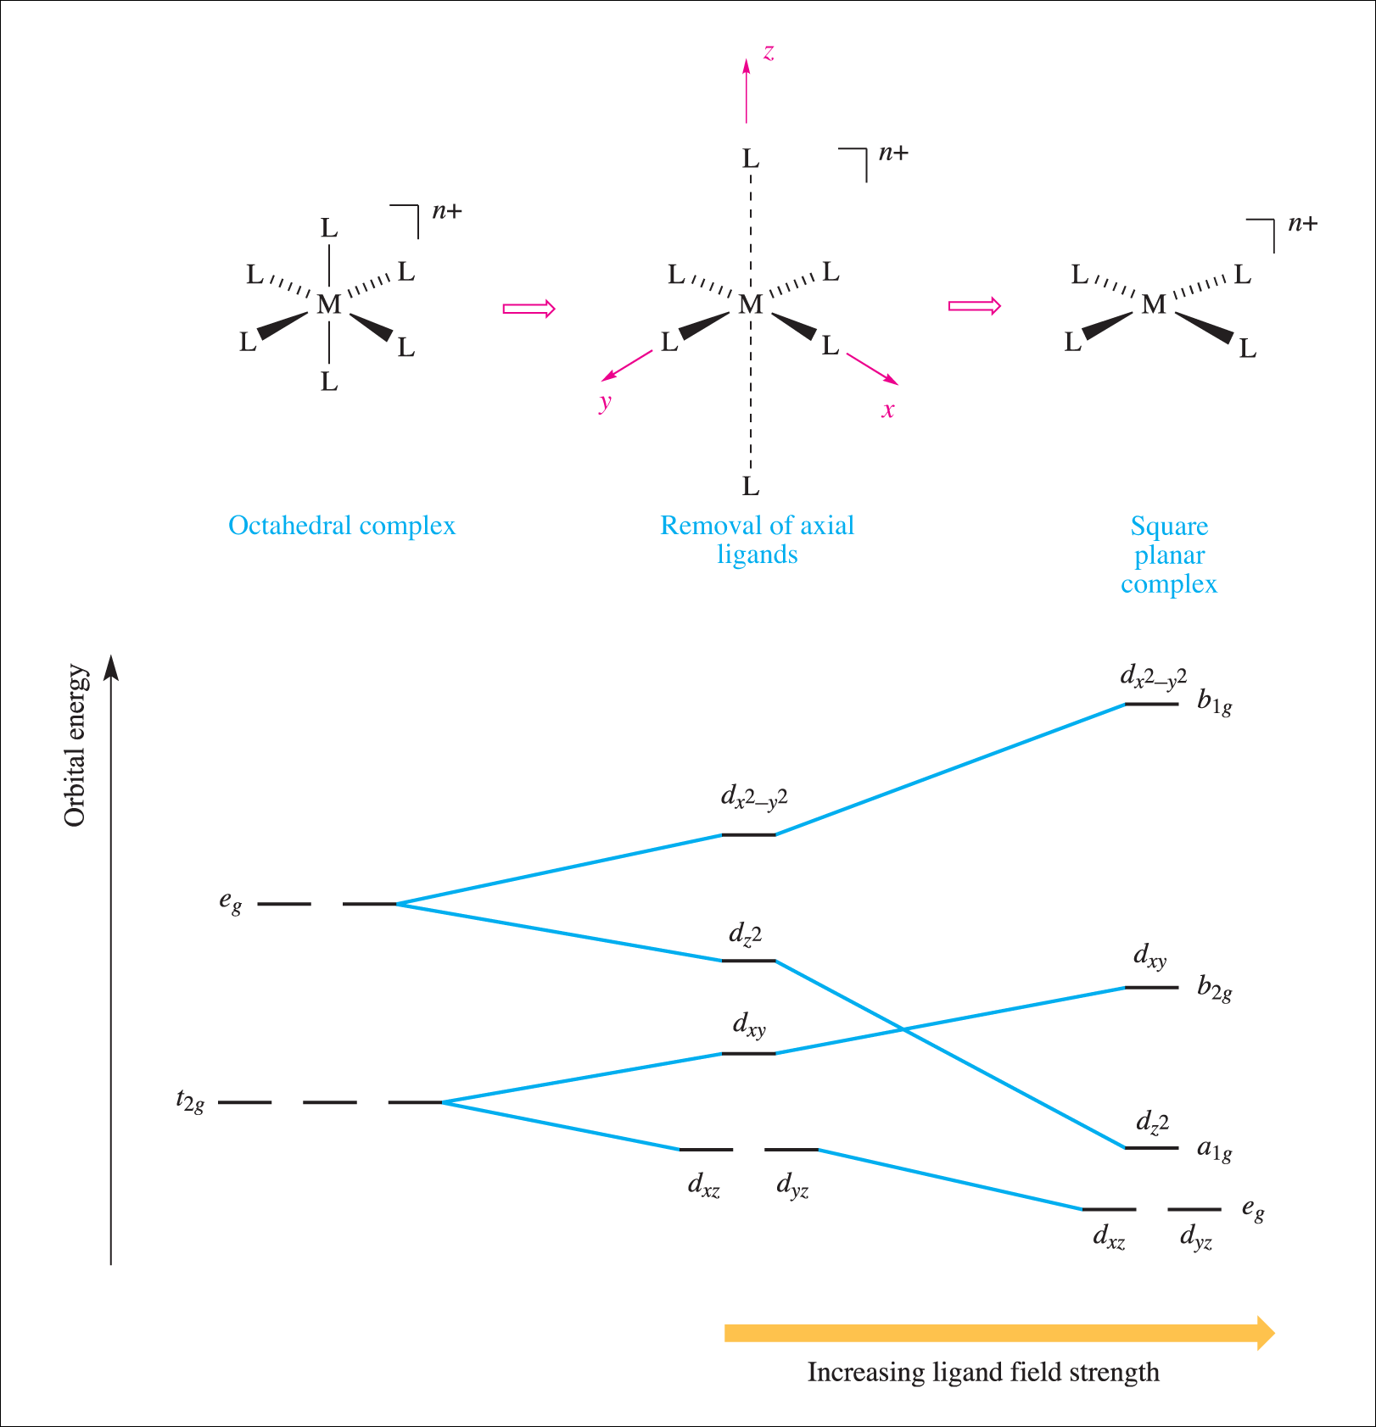
7. The Square Planar Crystal Field
Square planar coordination environment:
Point Group: d_{4h}
d⁸ is diamagnetic vs
paramagnetic for tetrahedral

Slide 24
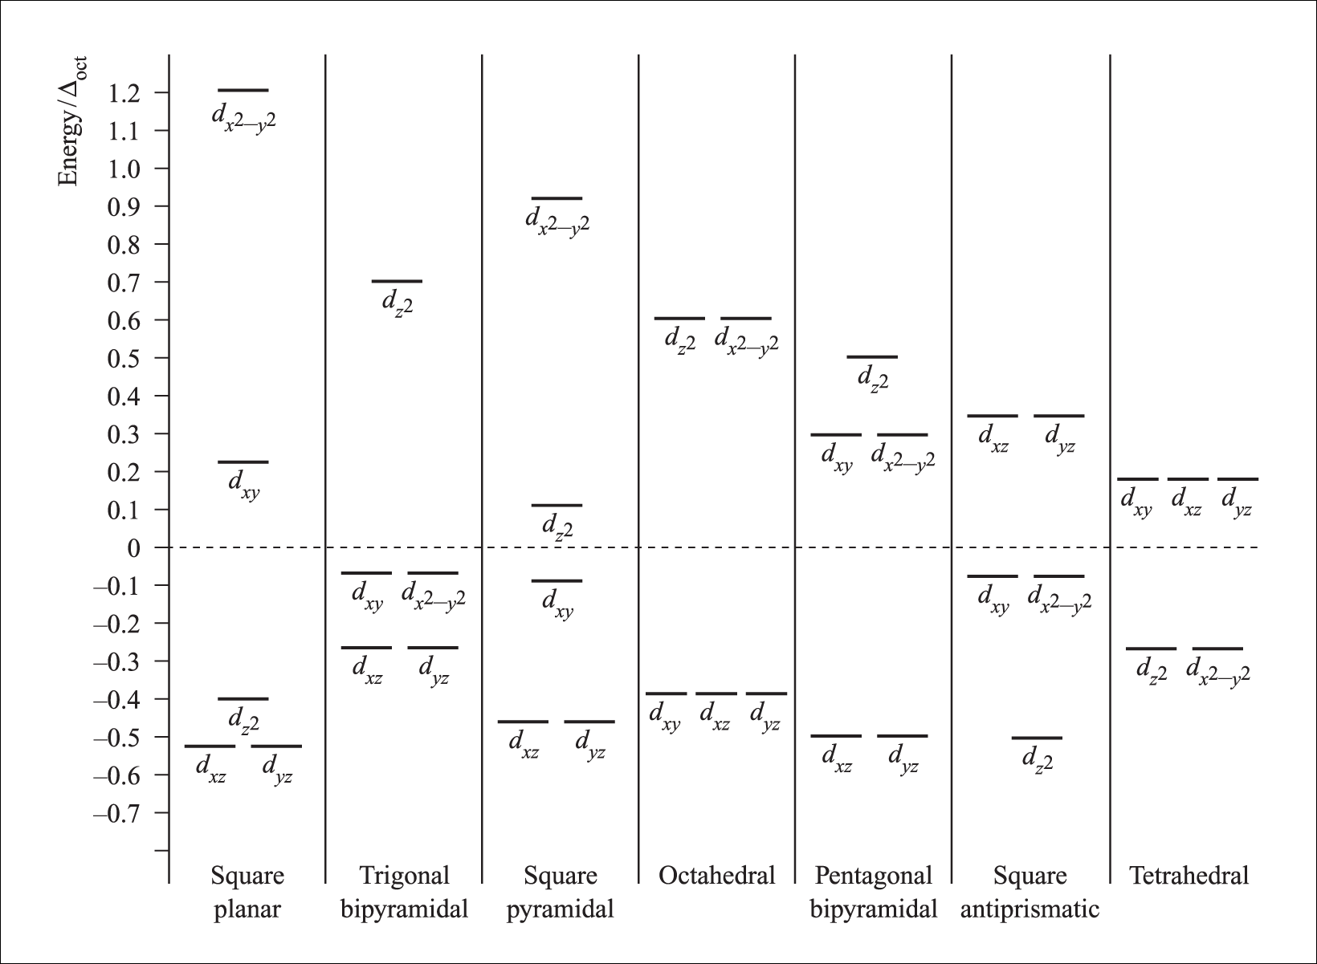
8. Crystal Field Splitting Diagrams for Common Geometric Fields

