Slide 1
Lead (Pb) as a feasible material in energy production and radiation shielding applications
Presented by:
Irivette Domínguez Martínez
Liz N. Santiago Martoral
Christian Santos Homs
Melissa Vega Cartagena

Slide 2
Metal Properties
Lead
Conductor
Resistant to corrosion
Ductile & Maleaable
Galena (PbS_{(s)})
Pure Lead
E
2 PbS_{(s)}+ 3 O_{2(g)}+ Heat → 2 PbO_{(s)}+ 2 SO_{2(s)}
2 PbO_{(s)} + Heat + C_{(s)} → 2 Pb_{(s)}+ CO_{2(g)}

Slide 3
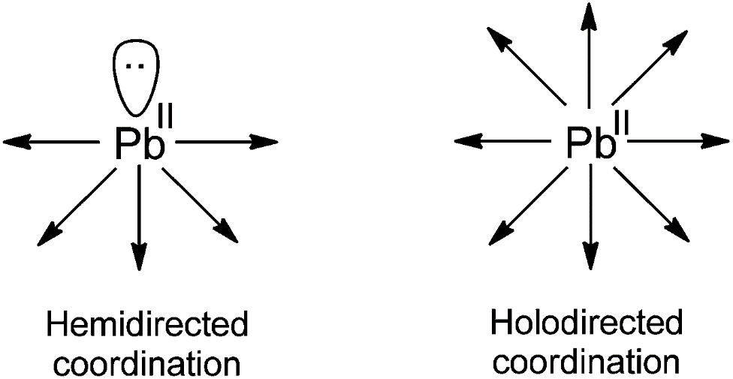
Coordination Chemistry
Pb ground state
Pb ⁺²
Pb ⁺⁴
6s
6p
Karmakar, A., Hazra, S., Guedes, F., Synthesis, structure and catalytic application of lead(II) complexes in cyanosilylation reactions. Royal. Soc. Chem., 44, 268–280 (2015).
Notes:
its large size (ionic radius 1.32 Å [5], covalent radius 1.54 Å [5] and van der Waals radius 2.00 Å [6]), which permits coordination numbers that range from quasione [7] to twelve [8] and (ii) its 6s electron pair, which may or may not play a role in the stereochemistry of lead(II) complexes [9]. The lone-pair activity can depend on (1) hard or soft ligands, (2) attractive or repulsive interactions among ligands, and (3) the number of electrons (charge) transferred from the ligands to the metal atom [3]. It has been proposed that holodirected structures do not necessarily exclude an inactive lone-pair [10].

Slide 4
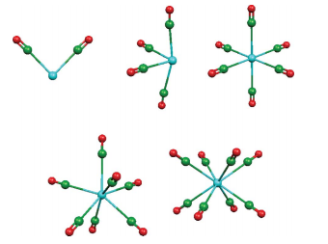
Coordination Chemistry for lead (II)
Pb:
C: [Pb(CO)_{n}]⁺²
O:
a
b
c
n=2: bent (C_{2V})
n=4: cis-divacant octahedral
n=6: octahedral (O_{h})
n=7: trigonal piramidal (C_{3V}) or pentagonal based pyramid (D_{5h})
n=8: decordinated
d
e
http://pubs.rsc.org/en/content/articlehtml/2011/dt/c1dt10604j
Notes:
6 MAS ESTABLE

Slide 5
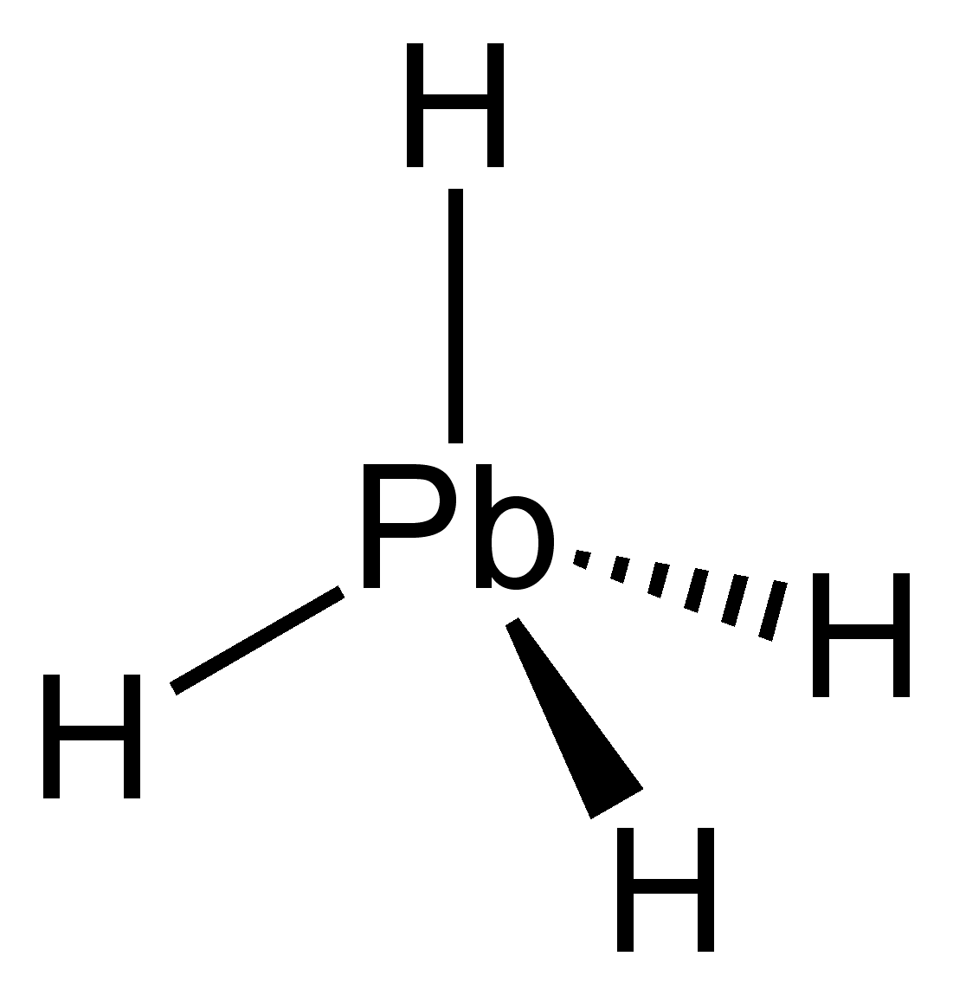
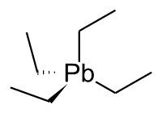
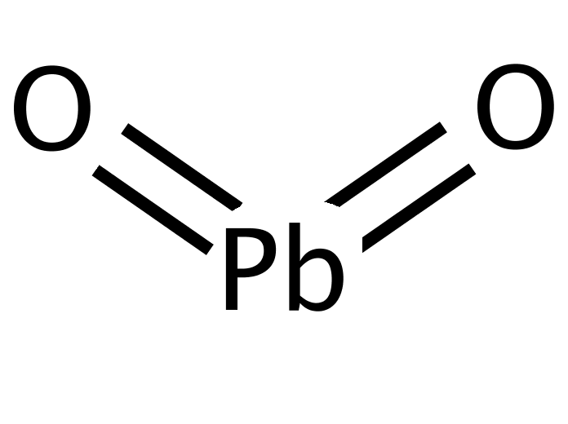
Coordination Chemistry for lead (IV)
Lead oxide
Black powder
Stable
а- orthorhombic
β- tetragonal
Used as electrode material
Plumbane
Gas
Highly unstable
Tetraethyllead
Colorless liquid
Gasoline additive
Highly toxic
Notes:
Importante relación estabilidad y tipo de ligando

Slide 6


Toxicity
Lead paints were widely used in homes until the late seventies
Still more than 38 million homes have lead Paint.
Also, lead was used extensively in plumbing such as pipes, fixtures and soldering.
As the metal wears down it can release toxic particles into the water i.e. flint
Notes:
Lead dust

Slide 7
Toxicity
Lead is a potent occupational toxin
Mechanims of lead toxicity:
Oxidative stress mechanism:
  two different pathways operative simultaneously
    The generation of ROS, like hydroperoxides (HO₂ •) and (H₂O₂).
    The antioxidant reserves become depleted.
Ionic mechanism: lead has the ability to substitute other bivalent cations like Ca²⁺, Mg²⁺, Fe²⁺ and monovalent cations like Na⁺.
Flora, G., Gupta, D., & Tiwari, A. (2012). Toxicity of lead: A review with recent updates. Interdisciplinary Toxicology, 5(2), 47–58. http://doi.org/10.2478/v10102-012-0009-2
Notes:
Glutationa It is an important antioxidant for quenching free radicals -
Reactive oxugen species
La estructura de trigonal piramidal es la estructura ideal para que el plomo se enlace a los grupos sulfohidrilos
he ionic mechanism contributes principally to neurological deficits, as lead, after replacing calcium ions, becomes competent to cross the blood-brain barrier (BBB) at an appreciable rate
ability to substitute other bivalent cations like Ca²⁺, Mg²⁺, Fe²⁺ and monovalent cations like Na⁺

Slide 8
Addressing lead toxicity
OSHA has set the permitted exposure limit for lead in the workplace as 0.05 mg/m³ over an 8-hour workday
WHO is currently developing guidelines on the prevention and management of lead poisoning
Recycling of the metal is increasing in popularity, around 80% of lead is being recycled from batteries and 6% is from other sources
Notes:
High reclying rates
which will provide policy-makers, public health authorities and health professionals with evidence-based guidance

Slide 9

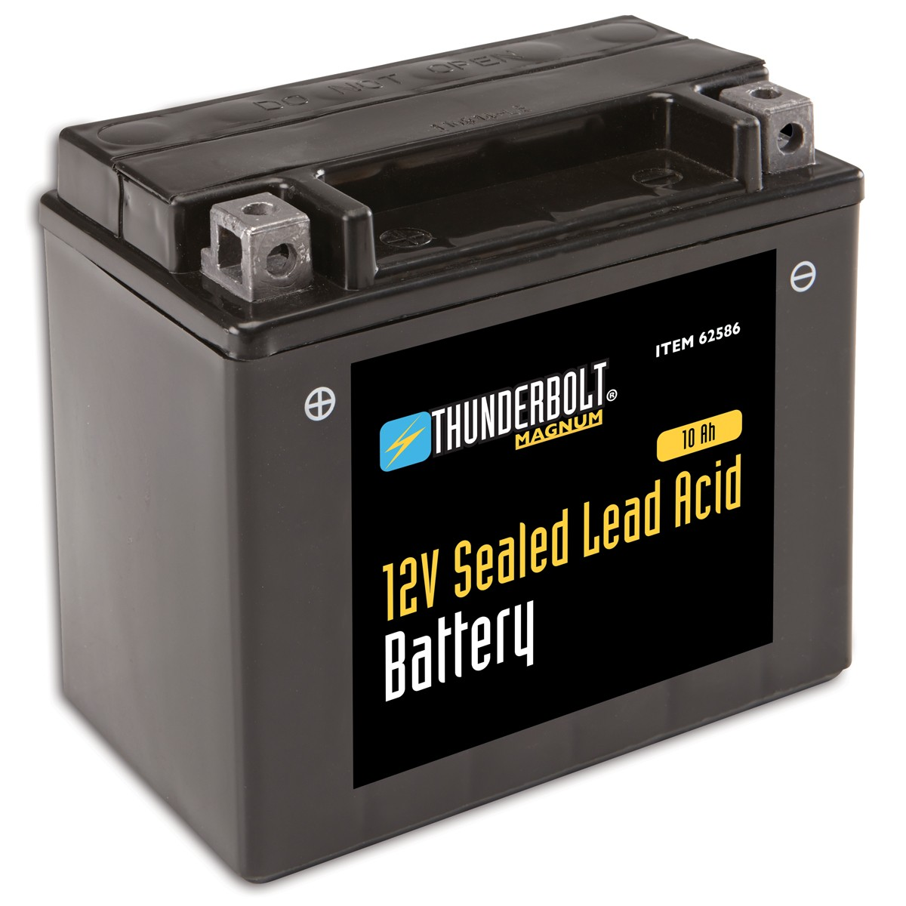

Applications

Slide 10
Lead Perovskite Solar Cells
Why lead is so special to make solar cells with perovskite?
Cheap to produce
Simple to manufacture
Fastest-advancing solar technology

Slide 11
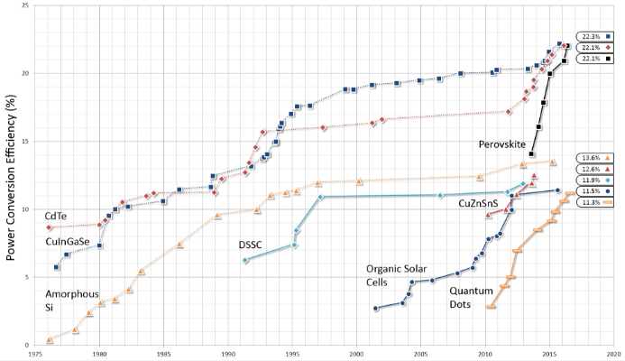
Lead Perovskite Solar Cells
22.1%
22.3%
22.1%
22.3%
Ke,W.,Fang,G.,Wang,J.,Qin,P.,Tao,H.,Lei,H.,Liu,Q.,Dai,X.,Zhao,X., People’s Republic of China.Perovskite Solar Cell with an Efficient TiO2 Compact Film. Mater Interfaces.6(18),15959-15965(2014)

Slide 12
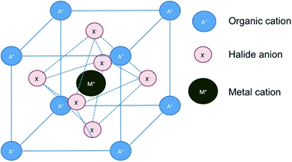
Lead Perovskite Solar Cells
Organic cation: CH₃NH₃⁺
(Atoms in the corner)
Halide ion: I ⁻ or Br –
(Atoms on the face)
Metal cation: Pb²⁺
(Atoms inside the lattice)
Kojima,A.,Teshima,K.,Shirai,Y.,Miyasaka,T.,Organometal Halide Perovskites as Visible-Light Sensitizers for Photovoltaic Cells.J. Am. Chem. Soc.131(17), 6050-6051 (2009)
Notes:
Also, the alteration of the unit cell will cost a change of color. If we have Br⁻ as a halide, the perovskite will change from colorless to yellow but if the halide is changed to an I⁻ the perovskite will have yellow as initial color and the final color and is black.

Slide 13
Lead Perovskite Solar Cells
Excellent semiconducting material. (1)
  Lead-Perovskite functions as: (2)
    Ambipolar semiconductor:
      Hole transporter (p-type)
      Electron transporter (n-type)
High efficiency:
    Light absorber (~300nm - 800nm)
    Transports the charges to the electrodes (p-n types) with minimum losses.
anode
n-type electrode
Perovskite
p-type electrode
cathode

Slide 14
Lead Perovskite Solar Cells
cathode
The addition of TiO₂ provides the perovskite less resistance and better electron transfer.
Power conversion efficiency of 3.8% to 9.7%increase with TiO₂
TiO₂ increases the long-term stability of the perovskite
p-type contact
TiO₂ + perovskite
n-type contact
anode
Notes:
Also, the alteration of the unit cell will cost a change of color. If we have Br⁻ as a halide, the perovskite will change from colorless to yellow but if the halide is changed to an I⁻ the perovskite will have yellow as initial color and the final color and is black.

Slide 15
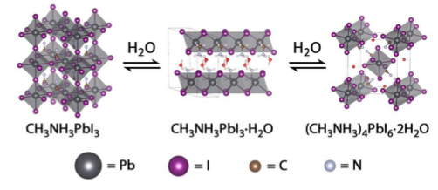
Lead Perovskite Solar Cells: Problematics
Tetragonal structure of methylammonium lead iodide
In the second phase the hydrogen bonding between water molecules and the methylammonium cations leads (3D → 2D)
The descompotion of the perovskite
Kelly,L.T.,Yang,J., Decomposition and Cell Failure Mechanisms in Lead Halide Perovskite Solar Cells. Inorg.Chem., A-J (2016)
Notes:
#2 hydrogen bonding between water molecules and the methylammonium cations leads to transformation of the 3D perovskite structure into 2D sheets separated by water molecules

Slide 16

Lead-perovskite charge recombination
hv
Glass
- - - - - - n-type - - - - - -
-
Recombination mechanism
-
-
+
Perovskite + TiO2
+
+ + + + + + p-type + + + + + +
Metal contact

Slide 17
Lead-Perovskite surface charge recombination
Solar cells problems:
  Reduction solar cell performance.
  Low efficiency.
  Short life.
Snaith et al. in 2014 propose a method to solving charge recombination problem.
  Article: Enhanced Photoluminescence and Solar Cell Performance via Lewis Base Passivation of Organic-Inorganic Lead Halide Perovskites.

Slide 18
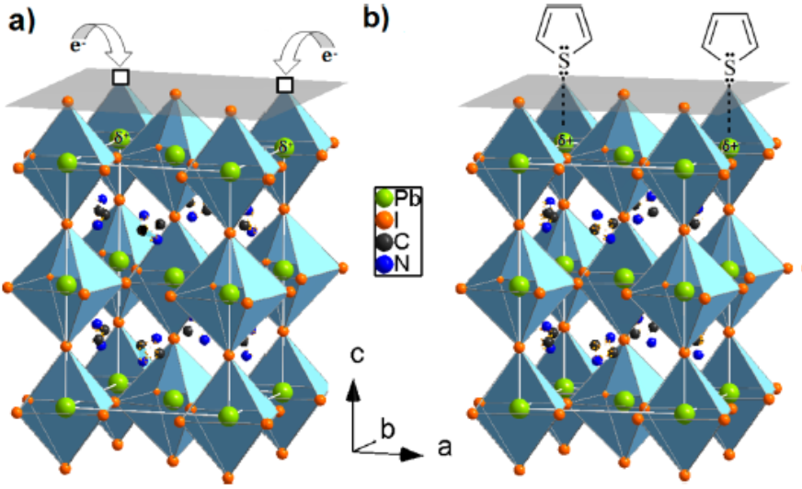
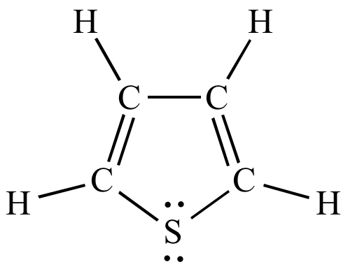
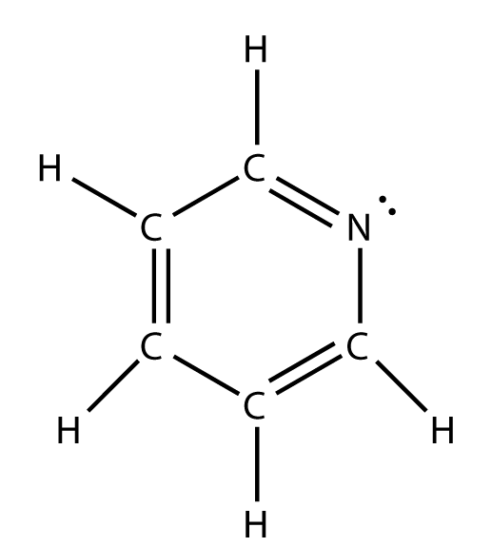
Enhanced Photoluminescence and Solar Cell Performance via Lewis Base Passivation of Organic-Inorganic Lead Halide Perovskites
Method:
Surface passivation with electron-rich molecules (Lewis bases) such as thiophene, pyridine, etc.
Noel, N. K., Abate, A., Stranks, S. D., Parrott, E. S., Burlakov, V. M., Goriely, A. & Snaith, H. J. Enhanced Photoluminescence and Solar Cell Performance via Lewis Base Passivation of Organic-Inorganic Lead Halide Perovskites. ACS Nano, 8, 9815–9821 (2014).

Slide 19
Enhanced Photoluminescence and Solar Cell Performance via Lewis Base Passivation of Organic-Inorganic Lead Halide Perovskites by Snaith el at.
  Snaith et al. postulated that the Lewis base molecules bind to the under-coordinated Pb ions in the perovskite crystal, thus passivating these defect sites.
  Decrease in the rate of nonradiative recombination in perovskite films.
  Increased the efficiency from 13% to 15.3% and 16.5% using thiophene and pyridine, respectively.
  The exact mechanism of passivation is subject to further investigation.

Slide 20
Lead Acid Battery
Why Lead is so special to make this battery ?
Inexpensive
Abundant
Reversible redox cycle

Slide 21
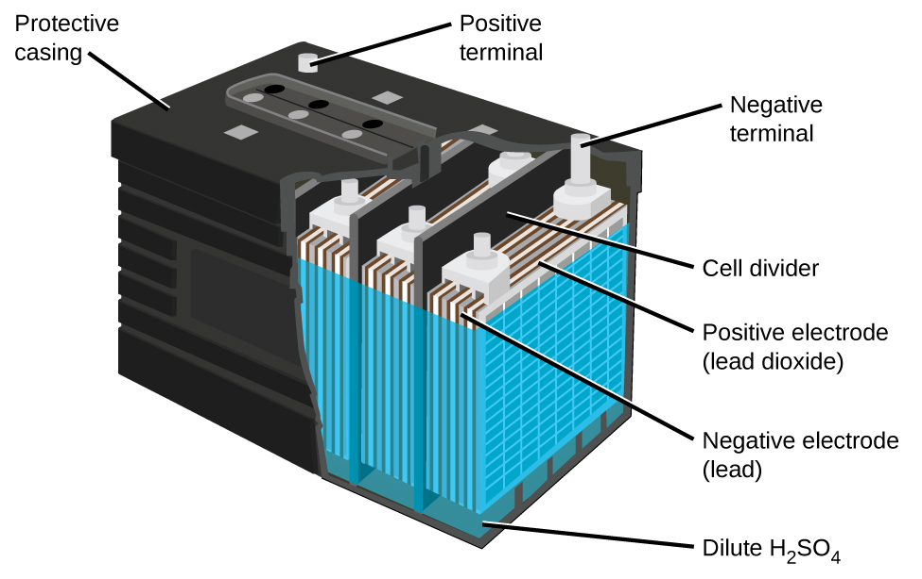
Car Battery
PbO₂
Pb
H₂SO₄
https://opentextbc.ca/chemistry/chapter/17-5-batteries-and-fuel-cells/

Slide 22
How it works?
Anode reaction:
Pb_{(s)} + SO₄²⁻ _{(aq)} → PbSO_{4 (s)} + 2 e⁻
Cathode reaction:
PbO_{2(s)} + 4 H⁺ _{(aq)} + SO₄²⁻ _{(aq)} + 2 e⁻ → PbSO_{4 (s)} + 2 H₂O_{(l)}
__________________________________________________________________________________
Overall Reaction:
Pb_{(s)} + PbO_{2(s)} + 2 H₂SO₄⁻ _{(aq)} → 2 PbSO_{4(s)} + 2 H₂O _{(l)}
Tro, N.J., Chemistry a Molecular Approach, Prentice Hall, New Jersey, 843 p, (2008)
0
+2
+4
+2
0
+4
+2

Slide 23
Reversible ?
Discharge
+
Charge
+
-
-
-
Flow →
of electrons
+
-
← Flow
of electrons
+
Cations
Cations
_{ANODE}
CATHODE
_{ANODE}
CATHODE
Anions
Anions
Oxidation
Reduction
Reduction
Oxidation
Electrolyte
Electrolyte

Slide 24
Consumption of lead in batteries (1960-2012)
Zhang, W., Yang, J., Wua, X., Hua, Y., Yu, W., Wang, J., Dong, J., Li, M., Liang, S., Hu, J. & Kumar, R. K. A critical review on secondary lead recycling technology and its prospect. Renewable and Sustainable Energy Rev., 61, 108–122 (2016).

Slide 25
The percentage of secondary lead and primary lead production from 1970 to 2012

Slide 26
Secondary lead recycling from acid-lead battery
Lead recovered from:
  Discarded lead acid battery (85%).
  Lead dust.
  Lead pipe.
  Lead glass of liquid crystal display (LCD).
  Slag from lead smelting process.
Benefits secondary lead recycling: (5)
  More cost-effective
  Conserve environmental resources
  Protect human health

Slide 27

Recycling lead process
Separate components
Acid
Recover
convert
Lead
Melt
Refine
Mold
Plastic
Cleaned and reprocessed into spheres

Slide 28
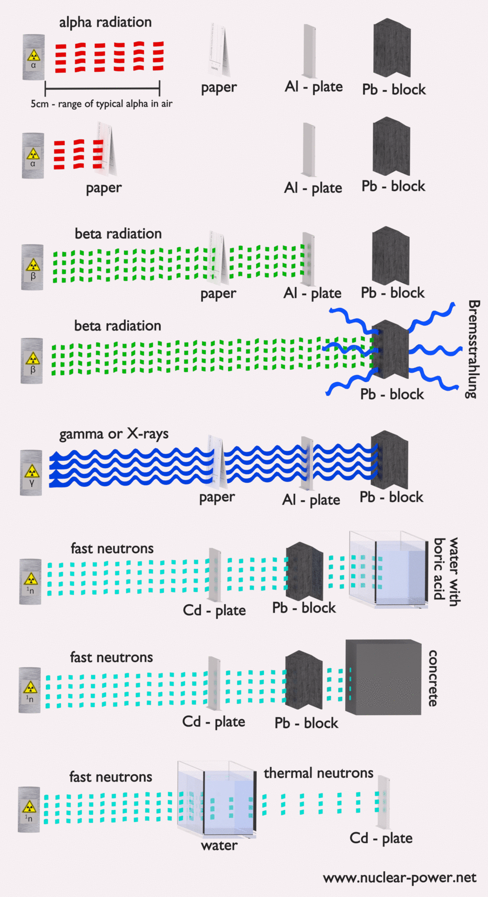
Radiation Shielding Material
http://www.nuclear-power.net/nuclear-power/reactor-physics/atomic-nuclear-physics/radiation/shielding-of-ionizing-radiation/

Slide 29
Lead: shielding material for cosmogenic radiation
Why use lead as shielding material?
high radiation absorption
thermal stability
resistant to damage but at the same time the irradiation effects on its mechanical properties should be small
Mass Attenuation Coeffient (µρ):Where 𝛍 is the attenuation coefficient and 𝝆 , this coefficient represents how easily a beam of energy can penetrate a material.
Notes:
the more atoms per volume unit, since the collisions increase because of more atoms, the energy of the incoming photons decreases.
The denser the material- facecentered cubic

Slide 30
Lead as a shielding material
Compton Effect - inelastic scattering of a photon by a charged particle
Lead plate
Target e-
Recoil e-
e-
Incident photon
Scattered photon

Slide 31
Lead as a shielding material
Photon
Photoelectron
Photoelectric Effect-
When light shines on a metal, electrons can be ejected from the surface of the metal
Metal plate
Notes:
Frecuencia para que ocurra es única del metal

Slide 32
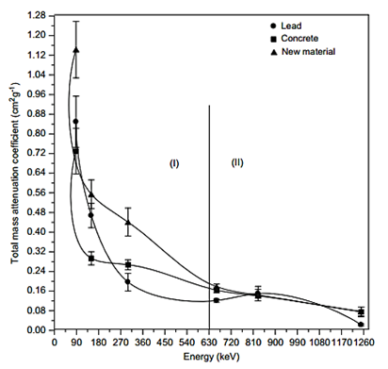
A Novel Shielding Material Prepared from Solid Waste Containing Lead for Gamma Ray by Erdem et. al
Cn+Pb
The experimental data was divided into two regions according to the applied photon energies, region I: 0.03 MeV - 0.6 MeV and region II: 0.63MeV - 1.15MeV.
Erdem, M., Oktay B., Mahmut D., and Fatih K., A Novel Shielding Material Prepared from Solid Waste Containing Lead for Gamma Ray. Rad. Phys. Chem, 79 (9), 917-22. (2010).
Notes:
there is an inversely proportional relation between the MAC and the photon energy.

Slide 33

Conclusion: Lead advantages
Lead-perovskite:
Low cost
High efficiency of the materials to form the structure that is greatly abundant.
Great potential to absorb light
Great semiconductor characteristics to generate electric potential charge.
Lead in batteries
Has shown to be more efficient because they can provide a relatively large current intensity,
Easy to recharge,
Durable metal
Can carry out electrochemical reactions efficiently

Slide 34
We encourage research with new technology to further enhance the retrieval of energy using more clean resources with less contamination to our planet, that promotes the reduced usage of pure metal and the recycling and reuse of discarded lead (i.e. from batteries, cells, and radiation blocks).

Slide 35


Slide 36
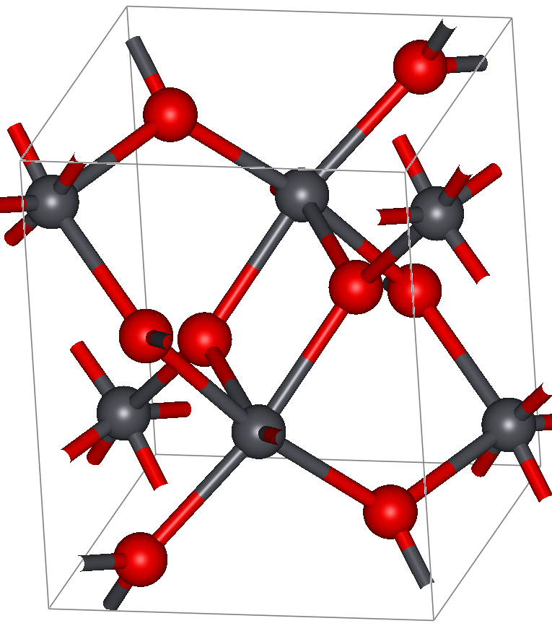
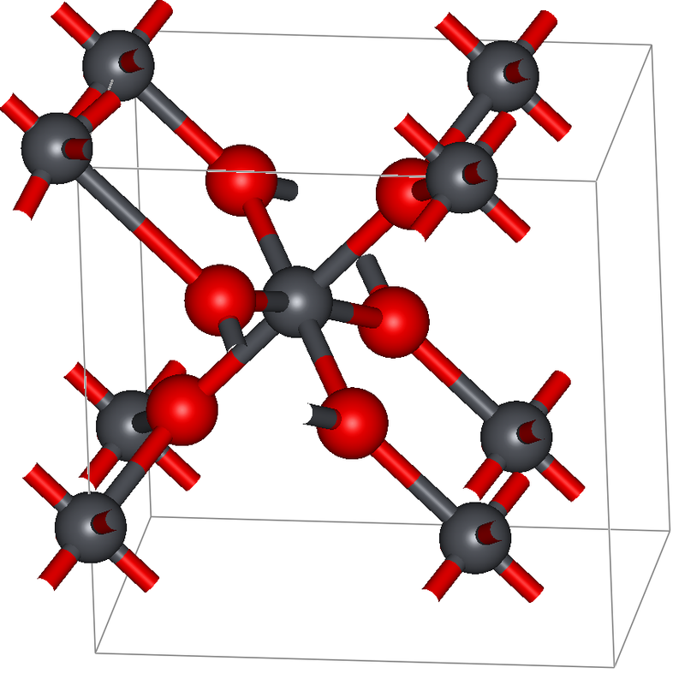
а- orthorhombic
β- tetragonal

Slide 37
