Slide 1
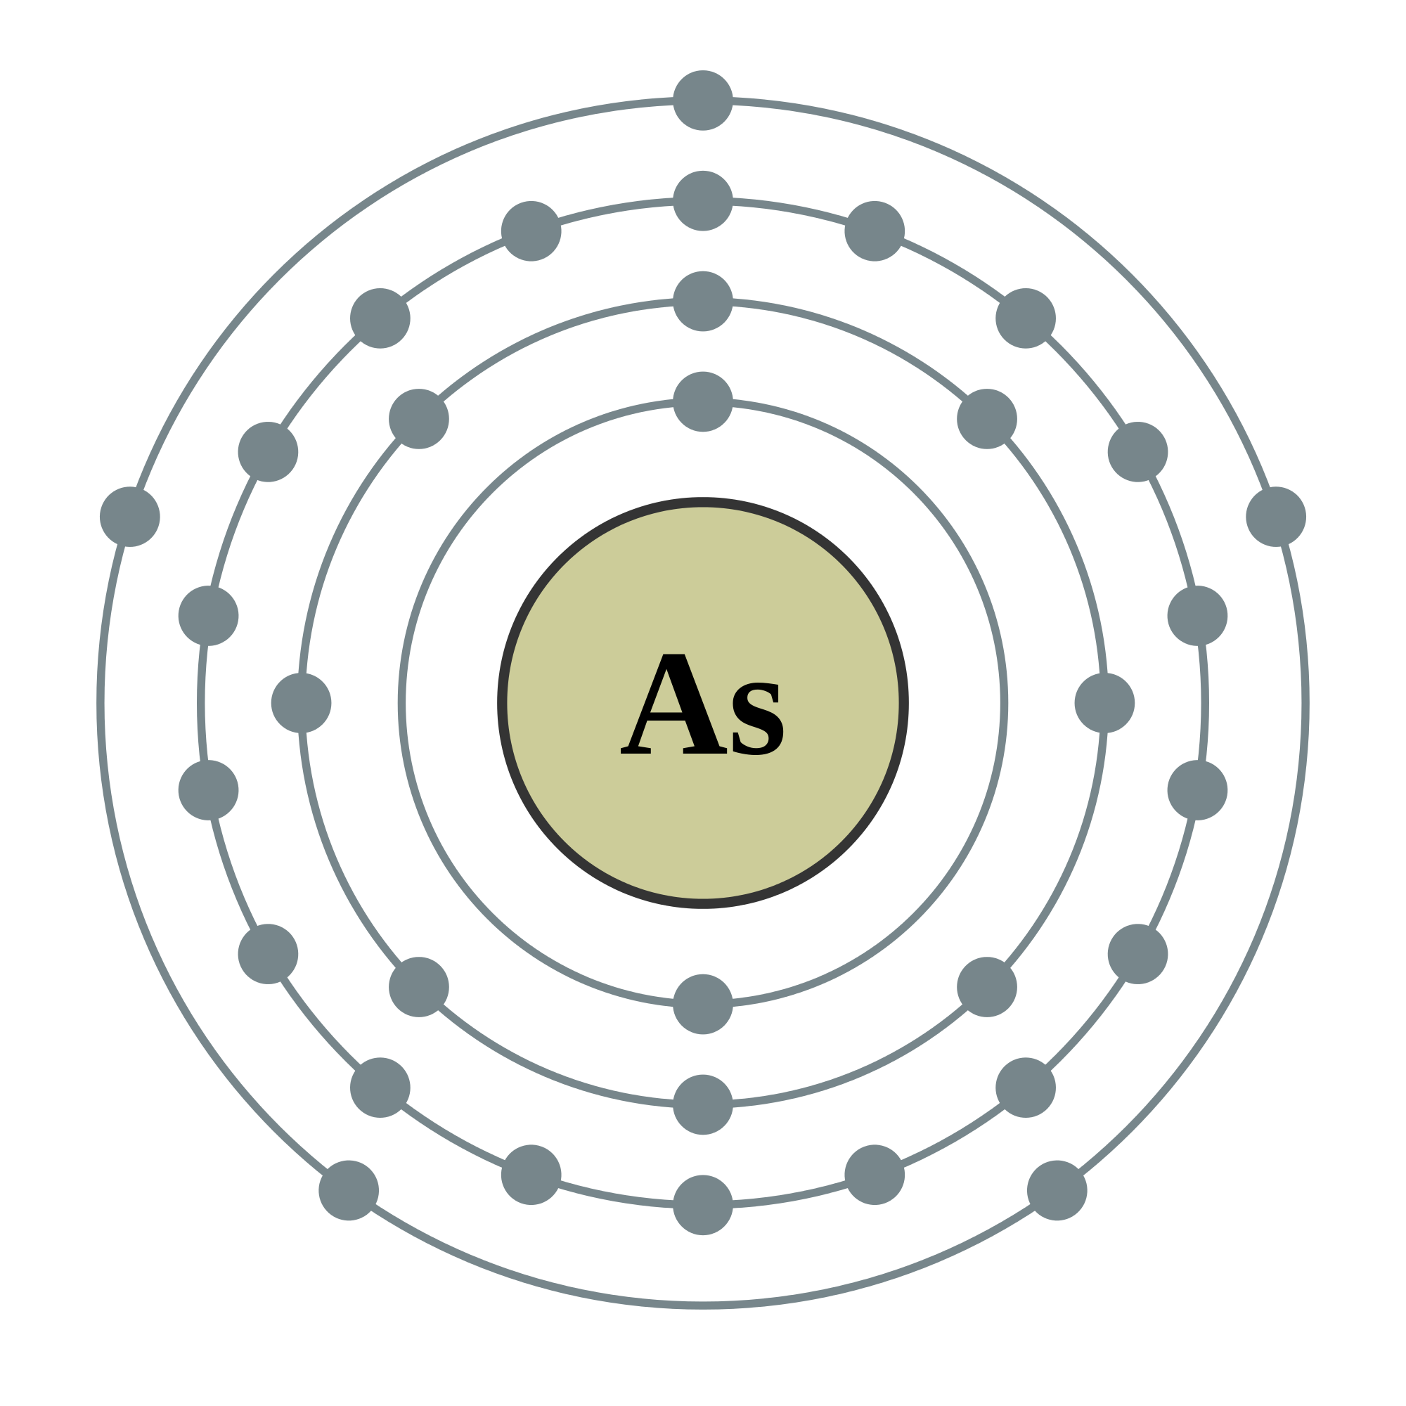
November 29, 2016
Christian Alicea
Israel Rodríguez
Wenndy Pantoja
http://colloidalfrere.blogspot.com/2015/03/arsenic.html

Slide 2
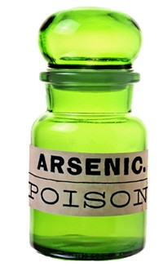
Arsenic: The King of Poisons
Albertus Magnus- is noted as the first to have discovered arsenic, around 1250 AD.
Used as a poison from the time of the Roman Empire through the Middle Ages and the Renaissance.
Arsenic trioxide (As₂O₃)
Lacks color, odor, and taste when mixed in food or drink.
Fatal dose is the size of a pea.
http://www.dartmouth.edu/~toxmetal/arsenic/history.html

Slide 3
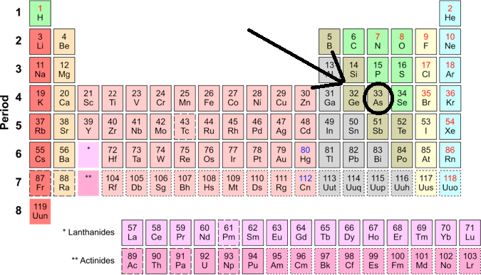
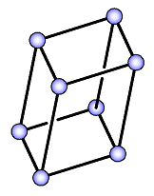
Properties
Chemical Formula: As
Atomic Number: 33
Molecular Weight: 74.92 grams
Number of protons/electrons: 33
Number of nuetrons: 42
Crystal Structure: Rhombohedral
Melting Point: No melting point but sublimes at 800 C.
Density @ 293 K: 5.72 g/cm³
Hardness: 3.5
https://sites.google.com/a/hightechhigh.org/cristinaa/8th-grade/math-science/elemental-superheroes
Notes:
Hardness: 3.5
Similar to clacite or flourite
Talc is 1 and diamond is 10
The most stable and most common form of arsenic at room temperature is a brittle, steel-gray solid ( α -As) with a structure analogous to that of rhombohedral black phosphorus. Arsenic vapor contains tetrahedral As 4 molecules, which are thought to be present in the yellow unstable arsenic formed by condensation of the vapor. Arsenic occurs naturally as α -As and also as the mineral arsenolamprite, which may have the same structure as orthorhombic black phosphorus.
Read more: http://www.chemistryexplained.com/A-Ar/Allotropes.html#ixzz4QKMOvgcr

Slide 4
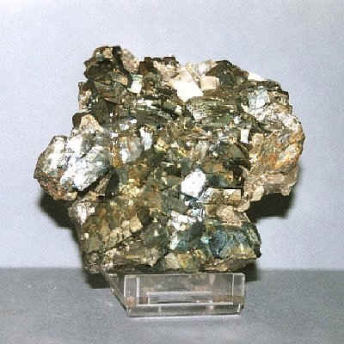
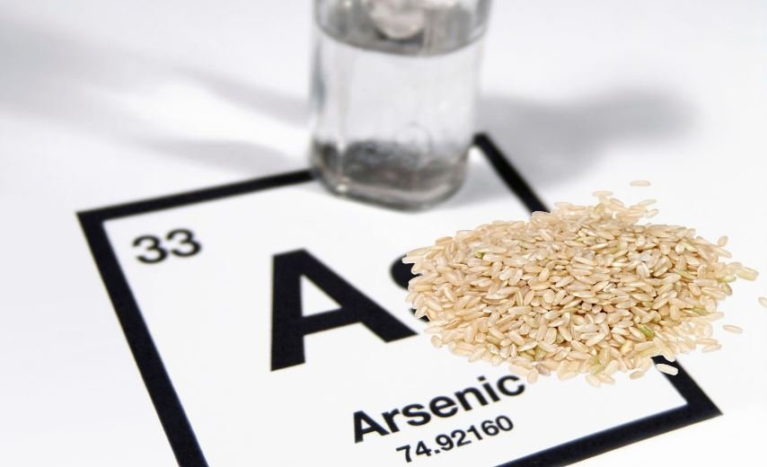
What is Arsenic?
Arsenic is a metalliod.
The element is found in nature, and in man-made products.
Levels of arsenic are found in soil, water and air.
Arsenic exists in different chemical forms in combination with other elements.
As combinations
H and C
Organic As
O, S, and Cl
Inorganic As
http://guardianlv.com/2013/09/fda-on-arsenic-and-rice-threat-are-we-all-at-risk/
Notes:
20th most abundant element in the earths crust.
There are reports of levels of arsenic found in rice.

Slide 5
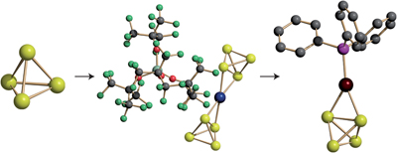
Allotropes
Arsenic has three main allotropes: the grey one whose atoms adopt a layered arrangement, the yellow one that consists of As₄ tetrahedra, and the black amorphous form.
Yellow form:
Pichon, A. Arsenic complex: Mellow yellow. Nature Chemistry. 5, 78 (2013)
Notes:
Add notes

Slide 6
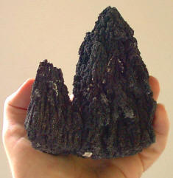
Inorganic vs Organic
Inorganic arsenic: found in rocks and soil or dissolved in water. This is the more toxic form.
Organic arsenic: mainly found in plant and animal tissues.
http://waterpollutionfilters.com/arsenic.htm
http://www.worldfishcenter.org/pages/gift/
Notes:
Seafood contains arsenic, but mostly the organic form. Rice and rice-based products may contain high levels of the inorganic (more toxic) form.

Slide 7
General Chemical Forms
As⁺³ or As⁺⁵
Organic forms:
Dimethylarsinic acid (DMA^{V}) (CH₃)₂As(O)OH
Monomethylarsonic acid (MMA^{V}) CH₃H₂AsO₃
Arsenbetaine (fish) (CH₃)₃As^{V}CH₂CO₂
Inorganic forms:
Sodium arsenite NaAs^{III}O₂
Sodium arsenate Na₂HAs^{V}O₄
Arsenic trioxide As^{III}₂O₃
Arsenic pentoxide As^{V}₂O₅
As^{III}(OH)₃
As^{V}O(OH)₃

Slide 8
Reactions
3+
3+
As₂O₃(s) + 6H₂(g) → 3H₂O(l) + 2AsH₃(g)
4As(s) + 5O₂(g) → As₄O₁₀(s)
As₄O₆ + 12HCl(aq) → 4AsCl₃(l) + 6H₂O(l)
AsCl₃(l) + Cl₂(g) → AsCl₅(s)
2As(s) + I₂(g) → 2AsI₃(s)
As₂S₃(s) + 6H₂O(l) → 3H₂S(g) + 2H₃AsO₃(aq)
0
5+
3+
3+
3+
5+
0
3+
3+
3+
http://www.chm.bris.ac.uk/motm/ascl5/ascl5v.htm
http://chem.libretexts.org/Core/Inorganic_Chemistry/Descriptive_Chemistry/Elements_Organized_by_Block/2_p-Block_Elements/Group_15%3A_The_Nitrogen_Family/Chemistry_of_Arsenic

Slide 9
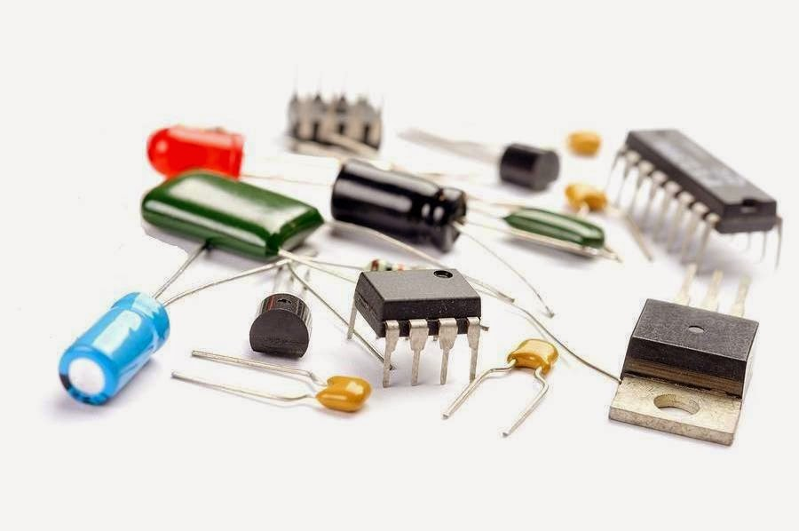
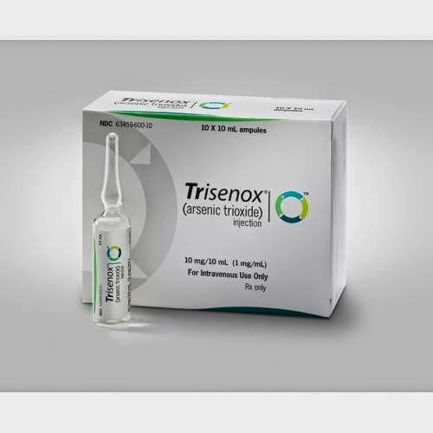
Applications
Wood preservative
Semiconductors
Medicine
http://siddhamedicares.blogspot.com/2014/04/our-ancient-siddha-medicine-vellai.html
http://www.elephantjournal.com/2012/11/arsenic-and-rice-a-deadly-combination-anna-hackman/
http://www.householdappliancesworld.com/2015/10/09/the-semiconductor-market-remains-stable/
Notes:
Anadir lo de medicina wenndy

Slide 10
Wood Preservative
Chromated copper arsenate (CCA)
CCA solutions contain chromium, arsenic and copper in the form of oxides or salts.
The chromium acts as a chemical fixing agent in CCA.
Arsenic is the main insecticidal component of CCA.
http://dir.indiamart.com/impcat/wood-preservative-treatment.html
Notes:
Anadir lo de medicina wenndy

Slide 11
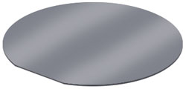
Semiconductors
A semiconductor is a solid element or compound, that can conduct electricity based on the environmental conditions.
Semiconductors have a current carrying capacity that is between conductors and isolators.
Silicon Wafer
http://www.highsnobiety.com/2012/10/24/the-evolution-of-the-imac-from-1998-to-today/
Notes:
A Silicon wafer at room temp can act as an isolater but when heated can conduct electrical current.
This special ability makes semiconductors the perfect brains for electronic devices. Circuits of small semiconductor switches called transistors are at the heart of computer chips and enable them to do math and run programs.
Arsenic is used in semiconductor material and has enabled electronics to become smaller, faster and more reliable.
C

Slide 12
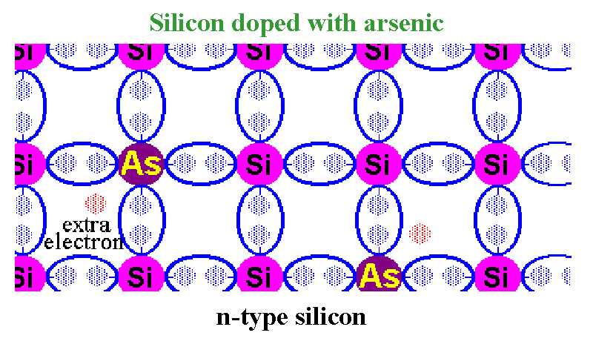
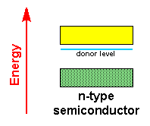
N-type Semiconductor
Conduction Band
Valence Band
Silicon: [Ne] 3s2 3p2
Arsenic: [Ar] 3d10 4s2 4p3
http://www.physics.udel.edu/~watson/ALLSTEL99/sld019.htm
Notes:
N type (pentavalent), improve the conductivity of the semiconductor at room temperature. Silicone only req. 4 electrons to maintain stability and in this case we have an extra (free) electron.
In the energy band picture the 5th electron lies in the forbidden band, slightly below the conduction band. This level is known as the donor level. The arsenic atom becomes positively charged. Each impurity atom donates one free electron to the semiconductor. These impurity atoms are called donors.

Slide 13
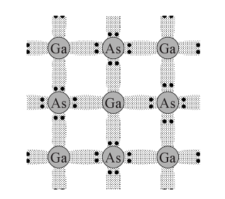
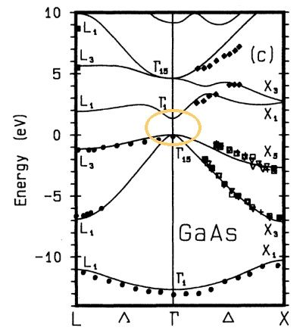
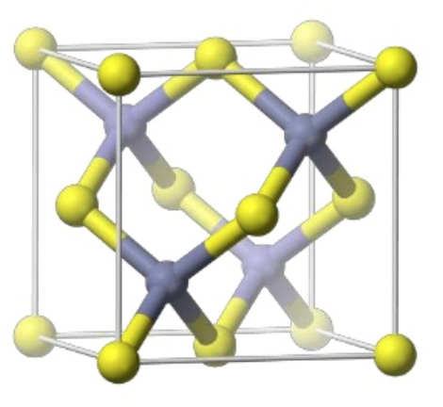
Gallium Arsenide
Band structures help determine the electron properties in a crystal.
Direct band gap of 1.43 eV
Crystal Structure is zinc blende lattice.
face-centered cubic
Finds application in semiconductor devices as diodes and transistors.
http://chemistry.stackexchange.com/questions/9317/how-many-ga-atoms-are-connected-to-one-as-atom-in-solid-state-gallium-arsenide
Notes:
GaAs is similar to silicon but has a higher electron mobility.
In equipment produces less noise than silicon.
It is more resistant to radiation and is used in radioactive equipment.
At a direct bandgap, a crystal can absorb and emit light, much like an isolated atom. The band gap of gallium arsenide at room temperature is 1.43 eV, corresponding to light of the wavelength 870 nm in the near infrared.
E-K diagram or Band structure plot – shows the energy of electrons in the crystal as a function of momentum.
(energy along the verticle axis and momentum on the horizontal axis, is given along specific directions in the crystal, which are denoted by the symbols Γ, Δ, X, Λ, and L.
The energy of free electrons are not quantised, free electrons are described as waves.
For the free electron the relationship between energy and wavevector is given by a parabola.

Slide 14
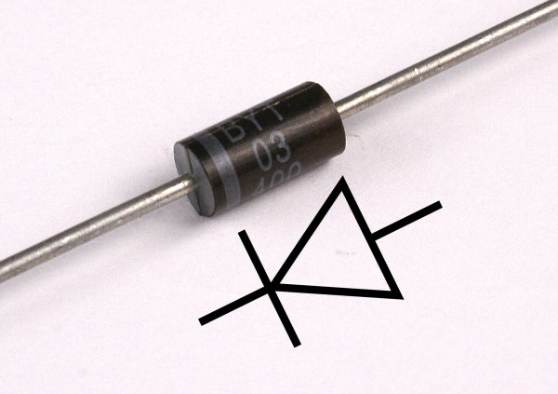
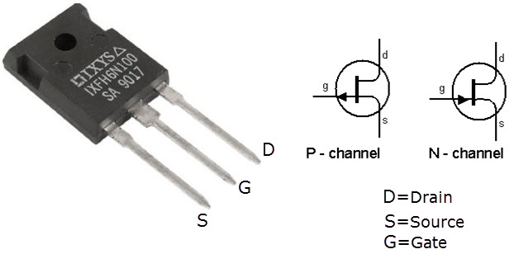
Diodes and Transistors
A diode is an electronic component in which current can flow in only one direction.
P-N Junction
A transistor is a electronic component that can work either as an amplifier or a switch.
Two diodes sandwiched back to back.
Amplifier- Current booster.
Switches- Depending on the applied voltage the transistor can be on or off.
Notes:
When we connect power to the diode the depletion area breaks and current flows through the diode.

Slide 15
Photon Emission in Semiconducting Material
When an electron meets a hole, it falls into a lower energy level, and releases energy in the form of a photon.
The wavelength of the emitted photon depends on the band gap of the semiconductor material.
Notes:
It turns out that whenever a carrier (electron or hole) jumps from one level to another, it is likely that a phenomenon known as "excitonic recombination" will happen which has the result of generating a photon.
When enough of those spontaneous effects happening, bulk light comes out of the device, like LEDs do.
When the above excitonic recombination happens inside an optical waveguide (something that confines light inside it), the device begins to resonate with itself, and from that point on an 'avalanche' effect where all electrons normally in the lower, comfortable, low energy band, jump into the excited state of the conduction band. This 'population' inversion is the basis on how any laser works.

Slide 16
OPTOELECTRONICS
http://advisionledsigns.com/make-your-led-sign-stand-out-with-color-contrast/
Notes:
Optoelectronic components: photocells, solar cells, LEDs (light-emitting diodes), and laser diodes.
Time Square, NYC

Slide 17
Layered Semiconducting Material
Liu B, Köpf M, Abbas A a., et al, Black Arsenic-Phosphorus: Layered Anisotropic Infrared Semiconductors with Highly Tunable Compositions and Properties, 11, 2015.

Slide 18
Black- Arsenic Phosphorus (b-AsP)
Structure of layered b-AsP. a) Side view b) top view of b-AsP
Characterization methods:
Field Effect Transistors- Charge transport properties
Polarized Vibrational Infrared Absorption
Liu B, Köpf M, Abbas A a., et al, Black Arsenic-Phosphorus: Layered Anisotropic Infrared Semiconductors with Highly Tunable Compositions and Properties, 11, 2015.
Notes:
The layered b-AsP material has a orthorhombic structure with a puckered honeycomb lattice. With an arsenic concentration of 83 percent the b-AsP material can produce a small band gap of 0.15 eV corresponding to 8.27 μm, allowing sensors to detect long wavelength infrared radiation.

Slide 19
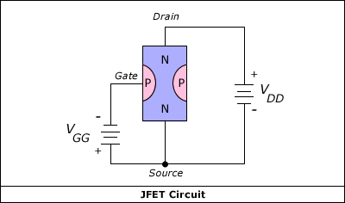
Field Effect Transistors (FETs)
Increase V_{G}
Increase depletion region
http://www.electrotechservices.com/electronics/junction_field_effect_transistors.html
Notes:
The FET controls the flow of electrons (or electron holes) from the source to drain by affecting the size and shape of a "conductive channel" created and influenced by voltage (or lack of voltage) applied across the gate and source terminals. (For simplicity, this discussion assumes that the body and source are connected.) This conductive channel is the "stream" through which electrons flow from source to drain.
on/off current
ratio of 1900

Slide 20
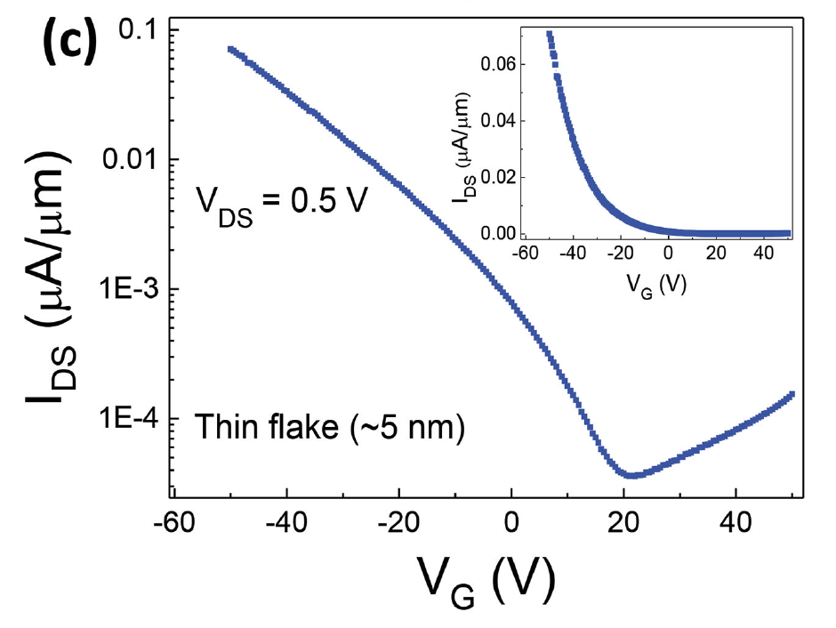
Field Effect Transistors (FETs)
Transfer curve of a 5nm thick b-As_{0.83}P_{0.17} samples.
This device shows ambipolar transport behavior and an on/off current
ratio of 1.9x10³.
Liu B, Köpf M, Abbas A a., et al, Black Arsenic-Phosphorus: Layered Anisotropic Infrared Semiconductors with Highly Tunable Compositions and Properties, 11, 2015.
Notes:
When the flakes become thin, increased gate modulation to the channel conductance was observed.
These transport measurements reveal the semiconducting nature of b-AsP materials.

Slide 21
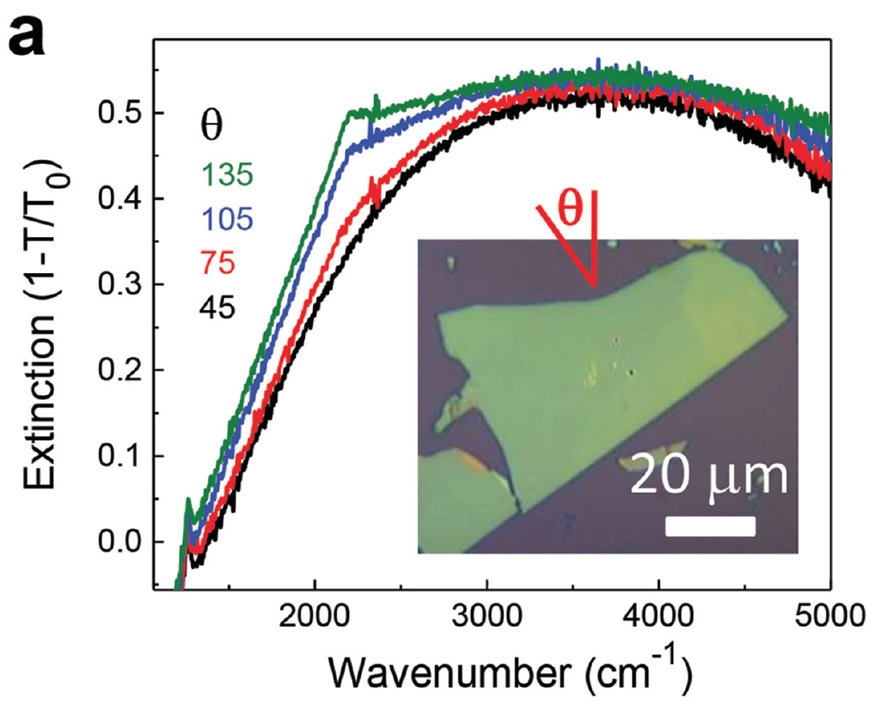
B-AsP: Infrared Adsorption
E = hc/λ
ṽ = 1/λ
ṽ = 1250 cm⁻¹
E = 0.15eV
λ = 8265 nm
Polarization-resolved infrared absorption spectra of b-As_{0.83}P_{0.17} materials at different polarization angles.
Liu B, Köpf M, Abbas A a., et al, Black Arsenic-Phosphorus: Layered Anisotropic Infrared Semiconductors with Highly Tunable Compositions and Properties, 11, 2015.
Notes:
Polarization-resolved infrared absorption spectra of b-As_{0.83}P_{0.17} materials at different polarization angles.
Conducting material such as semiconductors have moderately strong molecular vibrations in the IR region.
The results show that this material has an absorption edge of around 1250 cm −1 , corresponding to a band gap of 0.15 eV.
For instance, light detection and ranging (LiDAR) sensors work in this wavelength range. They are utilized as distance sensors in automobiles and in the measurement of trace gases and dust particles in environmental monitoring, amongst other applications.

Slide 22
Arsenene
Structural models of As in the bulk form and of its monolayer form.
Side view bulk form
Top view bulk form
Top view monolayer
Side view monolayer
Density functional theory (DFT)
Computational codes used to investigate the structural, magnetic and electronic properties of molecules.
Zhang S, Yan Z, Li Y, Chen Z, Zeng H., Atomically Thin Arsenene and Antimonene : Semimetal – Semiconductor and Indirect – Direct Band-Gap Transitions, 3155-3158, 2015.

Slide 23
Arsenene
Band structures of a solid describes the range of energies that an electron within the solid may have and ranges of energy that it may not have.
620nm
Electronic band structures of arsenic trilayers, bilayers, and monolayers Fermi levels.
Zhang S, Yan Z, Li Y, Chen Z, Zeng H., Atomically Thin Arsenene and Antimonene : Semimetal – Semiconductor and Indirect – Direct Band-Gap Transitions, 3155-3158, 2015.
Notes:
When the multilayer sample is thinned to a bilayer a small band gap of 0.37 eV is calculated. At this point the valence band top and the conducting band bottom of the As bilayer mainly consist of As 4p states. Figure 10 shows that when the thickness is reduced the conducting bands of the monolayer shift towards the vacuum level. In arsenene the conduction-band bottom mainly consists of As 4p states coupled with small amounts of 4s states; six As 4p states split into three bonding and three antibonding states forming a band gap around the Fermi level.
semi-metallic in bulk to semiconducting as a single-atom layer.

Slide 24
Indirect-to-Direct Band-Gap Transition
Electronic band structures of arsenene upon applying a biaxial tensile strain.
a) under 1% tensile strain b) 4% tensile strain c) 12 % tensile strain.
Zhang S, Yan Z, Li Y, Chen Z, Zeng H., Atomically Thin Arsenene and Antimonene : Semimetal – Semiconductor and Indirect – Direct Band-Gap Transitions, 3155-3158, 2015.
Notes:
Under 0–3% tensile strain, the CBM of monolayer arsenene remains in the Brillouin zone halfway between the Γ and M high-symmetry points. Increasing the strain up to 4% shifts the CBM to the Γ highsymmetry point, which rapidly transforms arsenene into a direct band-gap semiconductor.
short-wavelength optoelectronic devices such as blue or ultraviolet light-emitting diodes.

Slide 25
Arsenic in the Environment
Yogarajah N., Tsai S., Environ. Sci.: Water Res. Technol.,00,1-21 ,2015

Slide 26
Limits and Standards
WHO
OSHA
WHO
Tolerable intake level
3.0 μg/kg
Body weight per day
Drinking Water
Can not be Established
Air
3.0 μg/kg
OSHA
Water
10 μg/L
Air (PEL)
5 μg/m3
Action level
10 μg/m3

Slide 27
https://www.google.com.pr/maps/place/Bangladesh/@23.1767623,88.8871819,6.36z/data=!4m5!3m4!1s0x30adaaed80e18ba7:0xf2d28e0c4e1fc6b!8m2!3d23.684994!4d90.356331

Slide 28
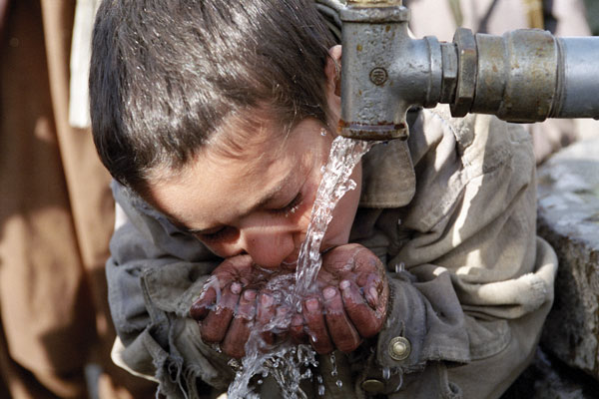
Bangladesh
Studies (2000- 2009) suggests that 20% of all deaths in Bangladesh are due to arsenic poisoning coming from drinking water.
The World Health Organization (WHO) contamination limit for arsenic in drinking wáter, as defined in 1993, is 0.01 mg/L.
Arsenic poisoning coming from drinking water is known as Arsenicosis.
http://www.aglobalvillage.org/journal/issue7/waste/arsenic/

Slide 29
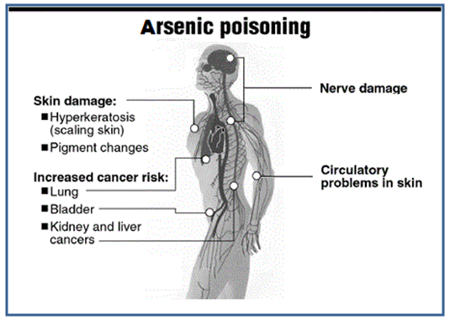
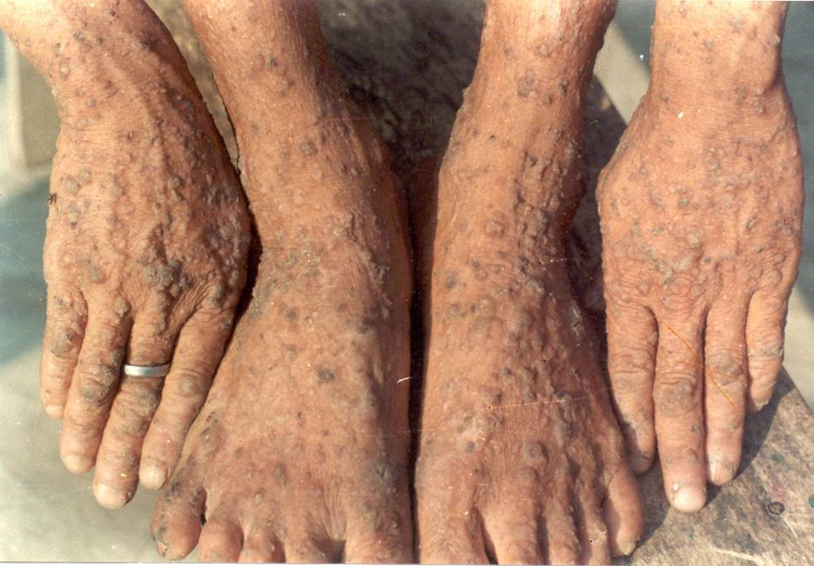
Arsenic poisoning or arsenicosis
http://article.sapub.org/10.5923.c.ije.201501.11.html
Notes:
caused by the ingestion, absorption or inhalation of dangerous levels of arsenic

Slide 30
Arsenic Species in Water
Arsenic (III) and (V) are the most common species in water.
Arsenic (III) → Arsenite
Arsenic (V) → Arsenate
Yogarajah N., Tsai S., Environ. Sci.: Water Res. Technol.,00,1-21 ,2015
http://www.osmonicbd.com/arsenic_treatment.html

Slide 31
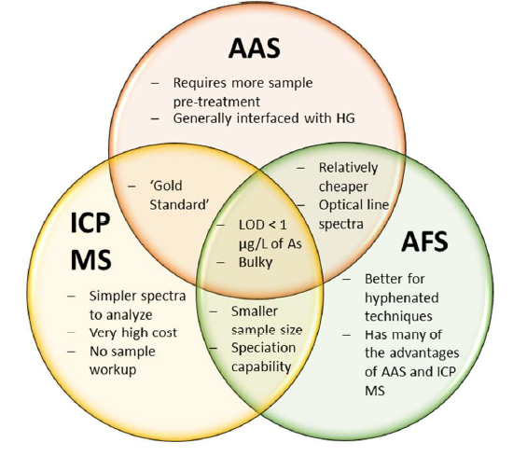
Arsenic Detection

Slide 32
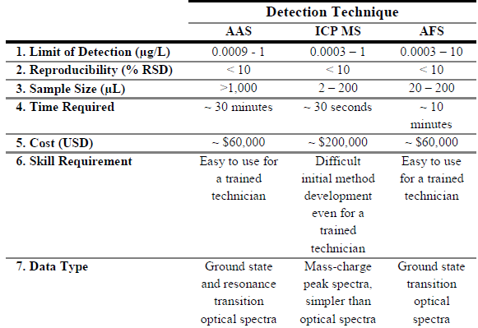
Arsenic Detection
Yogarajah N., Tsai S., Environ. Sci.: Water Res. Technol.,00,1-21 ,2015

Slide 33
Portable Test Kits
Based on the modified Gutzeid Reaction
Zn^{º} ⇨ Zn²⁺ + 2e⁻
2H⁺ + 2e⁻ ⇨ H₂
As³⁺ + 3e⁻ ⇨ Asº
Asº + 3e⁻ + 3H⁺ ⇨ AsH₃
AsH₃ + 3HgBr₂ ⇨ As(HgBr)₃ +3HBr
(1-4) are equivalent to the arsine gas generation and (5) colored strip generation.

Slide 34
Benefits of Kit
Yogarajah N., Tsai S., Environ. Sci.: Water Res. Technol.,00,1-21 ,2015

Slide 35
Limitations
The modified reaction reduces all arsenic in solution to arsine gas, which is highly toxic.
The evolved gas is mixed with mercuric bromide to induce a yellow color change.
Intensity of color depends on -AsH₂ present. Human eyes have low sensitivity for yellow color.
Notes:
ADD sometype of figure looks weak

Slide 36
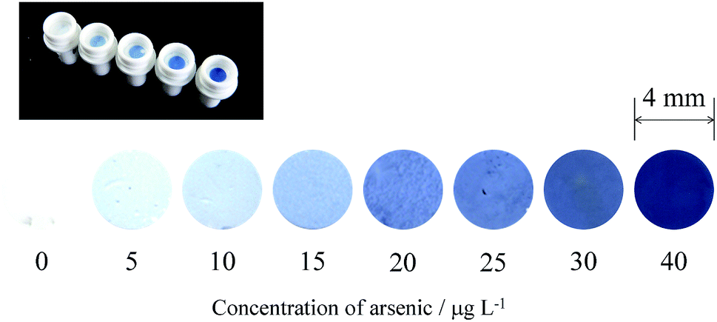
New Methods of Detection
Colorimetric methods such as:
Molybdenum Blue Test
Methylene Dye Test

Slide 37
Paper Based Sensor
Paper Based Sensors with microfluidics technology.
Yogarajah N., Tsai S., Environ. Sci.: Water Res. Technol.,00,1-21 ,2015
Notes:
Microfluidics: tactical application in which low volumes of fluids are processed to achieve multiplexing, automation and high throughput screening.
The reaction occurs with modified gold nanoparticles and the design makes it specific for As (III) and has LOD of concentrations of 1 micrograms per liter. The modified nanosensor binds to As (III) to produce a black blue precipitate that can be quantified.

Slide 38
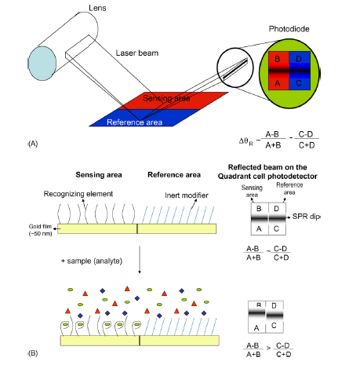
Surface Plasmon Resonance (SPR)
Forzani E.S, et al., Detection of arsenic in groundwater using a surface plasmon resonance sensor, Sensors and Actuators B 123, 82-88, 2007.
Notes:
This method consists of a stimulation of a permittivity material that has a positive and a negative interface. This stimulation is the resonant oscillation of conduction electrons through the material. For arsenic, the permittivity material is a gold nanoparticles film of approximately 50 nm thick. The film is divided in two areas: the sensing area that is coated with a material able to sense arsenic (glutathione (GSH) or dithiothreitol (DTT)) and a reference area that does not interact with the arsenic. The reason for using these reactants is because arsenic is strongly bound by sulphur groups. Arsenic can chelate up to three sulphurs at a time.

Slide 39
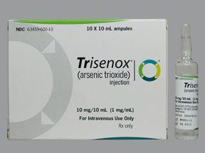
Medical Use
Arsenic is used to treat:
Rheumatism
Asthma
Ulcers
Syphilis
Cancer
Arsenic trioxide (As₂0₃) or trisenox is used to treat acute promyelocytic leukemia (APL).
http://onlinemedsus.com/product/Trisenox365610480944

Slide 40
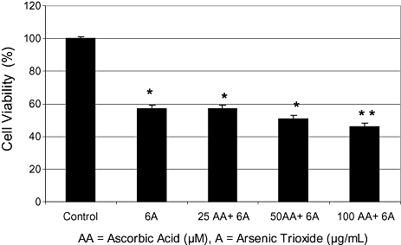
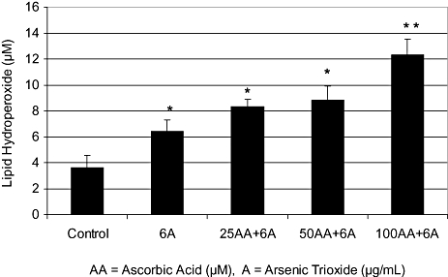
Arsenic trioxide (As₂O₃) used as a therapeutic agent to treat APL
a) Potential effect of co-administration of ascorbic acid (AA) and arsenic trioxide (As₂O₃) to human leukemia (HL-60) cells.
b) AA potentiation on As₂O₃-induced oxidative stress in HL-60 cells.
*Significantly different from the control by anova Dunnett's test; P < 0.05.
**Significantly different from As₂O₃ alone by anova Dunnett's test; P < 0.05.
Yedjou C, Thuisseu L, Tchounwou C, Gomes M, Howard C, Tchounwou P. Ascorbic Acid Potentiation of Arsenic Trioxide Anticancer Activity Against Acute Promyelocytic Leukemia. Archives of Drug Information. 2009;2(4):59-65.

Slide 41
Conclusion
Arsenic is best known as a metalloid.
Inorganic and organic forms.
The gray allotropes is the most important to the industry.
Alloy- Lead
Semiconductor- Optoelectronics
Medical Uses – Cancer treatment
Arsenic poisoning- Arsenicosis
Arsenic determination
Colorimetric methodologies
Portable kits
Arsenic compounds are still left to discover!!!!

Slide 42
References
Maud, J.; Rumsby, P. A review of the toxicity of arsenic in air, Environmental Agency, 2012.
Turunen, K.; Backnas, S.; Pasanen, A. Literature review of arsenic- sources, speciation, geochemical behavior and environmental effects, Geological survey of Finland report 99/2013.
Nazari, A. M.; Radzinski, R.; Ghahreman, A. Review of arsenic metallurgy: treatment of arsenical minerals and the inmobilization of arsenic. Hydrometallurgy, 2–205, 2016.
Chemistry of Arsenic. Libretexts. 2015. http://chem.libretexts.org/Core/Inorganic_Chemistry/Descriptive_Chemistry/Elements_Organized_by_Block/2_pBlock_Elements/Group_15%3A_The_Nitrogen_Family/Chemistry_of_Arsenic (Acceded Nov 1,2016)
Yogarajah N., Tsai S., Environ. Sci.: Water Res. Technol.,00,1-21 ,2015.
Smeester L., Rager J., Bailey K., Guan X., Smith N., García-Vargas G., Del Razo L., Drobná Z., Kelkar H., Styblo M., Fry R., Epigenetic Changes in Individuals with Arsenicosis, Chem. Res. Toxicol., 24, 165-167, 2011.
Liu, B.; Köpf, M.; Abbas, A. a.; Wang, X.; Guo, Q.; Jia, Y.; Xia, F.; Weihrich, R.; Bachhuber, F.; Pielnhofer, F.; Wang, H.; Dhall, R.; Cronin, S. B.; Ge, M.; Fang, X.; Nilges, T.; Zhou, C. Adv. Mater., 27, 4423–4429, 2015.

Slide 43
References
Sun, Q.; Song, Y.; Liu, S.; Wang, F.; Zhang, L.; Xi, S.; Sun, G. Atmos. Environ., 118, 1–6, 2015
Xie, S., Yang, M., Chen, K., Huang, H., Zhao, X., Zang, Y., Li, B., Efficacy of Arsenic Trioxide in the Treatment of Malignant Pleural Effusion Caused by Pleural Metastasis of Lung Cancer, Cell Biochemistry and Biophysics, 71, 1325-1333, 2015
Back Reaction. The Band Structure of Gallium Arsenide. http://backreaction.blogspot.com/2007/12/band-structure-of-gallium-arsenide.html (accessed Nov 1, 2016).
Obeng Y, Srinivasan P., Graphene: Is it the future for semiconductors? An overview of the material, devices, and applications. Electrochem Soc Interface. 20(1):47-52, 2011.
Coleman JN, Lotya M, O’Neill A, et al. Two-Dimensional Nanosheets Produced by Liquid Exfoliation of Layered Materials. Science. 331(6017):568-571, 2011.
Few-layer T, Chen L, Liu B, et al. Screw-Dislocation-Driven Growth.;(11):11543-11551, 2014.
Wang X, Jones AM, Seyler KL, et al. Highly anisotropic and robust excitons in monolayer black phosphorus. Nat Nanotechnol.;10(6):517-521,2015.
Liu B, Köpf M, Abbas A a., et al. Black Arsenic-Phosphorus: Layered Anisotropic Infrared Semiconductors with Highly Tunable Compositions and Properties. arXiv. 2015:11.

Slide 44
References
Zhang, S.; Yan, Z.; Li, Y.; Chen, Z.; Zeng, H. Angew. Chemie - Int. Ed., 54 (10), 3112–3115, 2015.
M. Argos, T. Kalra, P. J. Rathouz, Y. Chen, B. Pierce, F. Parvez, T.Islam, A. Ahmed, M. Rakibuz-Zaman, R. Hasan, G. Sarwar, V.Slavkovich, A. van Geen, J. Graziano and H. Ahsan, Lancet, 376, 252–8, 2010.
LENNTECH, Waterborne diseases, Arsenicosis; http://www.lenntech.com/library/diseases/arsenicosis/arsenicosis.htm (Accessed, Oct 26, 2016)
Jin B., Li Y., Robertson K., DNA Methylation: Superior or Subordinate in the Epigenetic Hierarchy?, Genes & Cancer, 2(6), 2011.
LENNTECH, WHO’s drinking water standards, 1993; http://www.lenntech.com/applications/drinking/standards/who-s-drinking-water-standards.htm (Accessed Oct 26, 2016)
U. Bose, M. Rahman and M. Alamgir, Int. J. Chem. Technol.,3,14–25, 2011.
I. D. Brindle, Anal. Bioanal. Chem.,388, 735–41, 2007.
Ohno, K., et. al, Microfluidics: Applications for analytical purposes in chemistry and biochemistry, Electrophoresis, 29, 4443-4453, 2008.
Forzani E.S, et al., Detection of arsenic in groundwater using a surface plasmon resonance sensor, Sensors and Actuators B 123, 82-88, 2007.
Yedjou, C., Thuisseu, L., Tchounwou, C., Gomes, M., Howard, C., Tchounwou, P., Ascorbic Acid Potentiation of Arsenic Trioxide Anticancer Activity Against Acute Promyelocytic Leukemia. Archives of drug information, 2, 59-65, 2009.

Slide 45
Questions

